Slide 1
MLU - Reinforcement Learning 1

Slide 2
Course Overview
Objective
This course serves as a first introduction to reinforcement learning
We will first introduce several fundamental concepts and then dive into classic approaches to solving reinforcement learning (RL) problems, paving the path for a further dive into Deep Reinforcement Learning
Main goals
Introduce key concepts intuition and their practical use
Introduce the commonly used approaches, solving simple problems using reinforcement learning in order to have a clear understanding on how to apply them
Introducing the main algorithms, understanding the underlying mechanisms and how to implement them using Python

Slide 3
Course Agenda
Lecture 1
Introduction to Reinforcement Learning
Finite Markov Decision Process
Bellman Equations
Dynamic Programming
Lecture 2
Monte Carlo Methods
Temporal Difference Learning
SARSA and Q-Learning
Lecture 3
On Policy Prediction and Control with Approximation
Off Policy Methods with Approximation
Lecture 4
Policy Gradient Methods
Lecture 5
Multi-armed Bandits

Slide 4
Reinforcement Learning
Lecture 1 - Introduction to RL, MDP, Bellman Equations and DP

Slide 5
Today’s Agenda
Lecture 1
Introduction to Reinforcement Learning
Key Concepts and Elements
Finite Markov Decision Process
Bellman Equations
Dynamic Programming
Value Iteration
Policy Iteration

Slide 6
Demo Code
The DEMO notebook used for this lecture is available in your SageMaker instance, named as RL1_lecture_1_demo.ipynb, into demos folder
You will find each DEMO code in the notebook index:
Gradient Descent
MC Approximator
Multiple Tiles for Multiple Features
TD(0) Approximator

Slide 7
Intro to Reinforcement Learning

Slide 8



Supervised Learning vs Reinforcement Learning
Supervised Learning
Uses a dataset to estimate relationships between features and a label. These estimates are then used on unlabeled data in order to predict new labels
Reinforcement Learning
Uses live data to predict what strategy is best in order to achieve a goal. Where Supervised Learning begins with a complete dataset, RL collects its data as a part of the process

Slide 9
Teaching a robot to stand up
How would Supervised Learning teach a robot to stand up?
Run a lot of experiments where a robot randomly selects an action
Would have to run enough times to cover all possible ways the robot can move and enough times to collect sufficient data
Would need to be run enough times that the robot actually does stand up
Build a regression, neural network or decision tree model that predicts an outcome
Example Outcomes:
Probability of Standing
Length of time Standing
Angle of Balance
etc…

Slide 10
Teaching a robot to stand up
How would Supervised Learning teach a robot to stand up?
A couple of problems
This requires a LOT of data
Success is not very likely as the robot will probably just fall over, so in order to gather enough data about how to stand, you’ll have to collect a lot of data about falling first
Requires data about all possible outcomes in order to be a complete dataset, and Supervised Learning needs a complete dataset
We only end up with a prediction, we haven’t modeled an objective or goal
Example: If you were a Data Scientist for a Presidential candidate and told them there’s a 20% chance they are going to win Iowa, that’s not very helpful. What they want to know is - what should they do to maximize their chance of winning? Maximizing their chance of winning is the goal

Slide 11


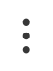
Teaching a robot to stand up
Solution!
Build the model as you collect the data, instead of afterwards. That way you only collect the data you need
Model an objective/goal: Balance Angle of 90° & Standing Height = Max(Length) of Robot
Action | Reward | Result
Twerk | -1 | 0°, 0
Push out right arm | -1 | 0°, 0
Push out left arm | 0.333 | 30°
Bend right leg | -1 | 0°
Bend left leg | -1 | 0°
$$⋮$$
$$⋮$$

Slide 12
Teaching a robot to stand up
Solution!
Build the model as you collect the data, instead of afterwards. That way you only collect the data you need
Model an objective/goal
Action | Reward | Result
Twerk | -1 | 0°, 0
Push out left arm | -1 | 0°, 0
Push out right arm | 0.333 | 30°
Bend right leg | -1 | 0°
Bend left leg | -1 | 0°
$$⋮$$
$$⋮$$
$$⋮$$

Slide 13
Teaching a robot to stand up
Solution!
Build the model as you collect the data, instead of afterwards. That way you only collect the data you need
Model an objective/goal
Action | Reward | Result
Twerk | -1 | 0°, 0
Push out left arm | -1 | 0°, 0
Push out right arm | 0.333 | 30°, 0.1
Bend right leg | -1 | 0°
Bend left leg | -1 | 0°
$$⋮$$
$$⋮$$

Slide 14
Teaching a robot to stand up
Solution!
Build the model as you collect the data, instead of afterwards. That way you only collect the data you need
Model an objective/goal
Action | Reward | Result
Twerk | -1 | 0°, 0
Push out left arm | -1 | 0°, 0
Push out right arm | 0.333 | 30°, 0.1
Bend right leg | -1 | 0°, 0
Bend left leg | -1 | 0°
$$⋮$$
$$⋮$$

Slide 15
Teaching a robot to stand up
Solution!
Build the model as you collect the data, instead of afterwards. That way you only collect the data you need
Model an objective/goal
Action | Reward | Result
Twerk | -1 | 0°, 0
Push out left arm | -1 | 0°, 0
Push out right arm | 0.333 | 30°, 0.1
Bend right leg | -1 | 0°, 0
Bend left leg | -1 | 0°, 0
$$⋮$$
$$⋮$$

Slide 16
Teaching a robot to stand up
Solution!
Build the model as you collect the data, instead of afterwards. That way you only collect the data you need
Model an objective/goal
Action | Reward | Result
Twerk | -1 | 0°, 0
Push out left arm | -1 | 0°, 0
Push out right arm | 0.333 | 30°, 0.1
Bend right leg | -1 | 0°, 0
Bend left leg | -1 | 0°, 0
When the robot is on its right side, the best action is to push from its right arm
$$⋮$$
$$⋮$$

Slide 17
Teaching a robot to stand up
Solution!
Build the model as you collect the data, instead of afterwards. That way you only collect the data you need
Model an objective/goal
Action | Reward | Result
Twerk | -1 | 0°, 0
Bring in right arm | -1 | 0°, 0
Push out left arm | -1 | 0°, 0
Bend right leg | 0.5 | 45°, 0.15
Bend left leg | -1 | 0°, 0
$$⋮$$
$$⋮$$

Slide 18
Teaching a robot to stand up
Solution!
Build the model as you collect the data, instead of afterwards. That way you only collect the data you need
Model an objective/goal
Action | Reward | Result
Twerk | -1 | 0°, 0
Push out right arm | -1 | 0°, 0
Bring in left arm | -1 | 0°, 0
Extend right leg | -1 | 0°, 0
Bend left leg | 0.90 | 90°, 0.15
$$⋮$$
$$⋮$$
$$⋮$$

Slide 19
Teaching a robot to stand up
Solution!
Build the model as you collect the data, instead of afterwards. That way you only collect the data you need
Model an objective/goal
Action | Reward | Result
Twerk | -1 | 0°, 0
Push out right arm | -1 | 0°, 0
Bring in left arm | -1 | 0°, 0
Extend right leg | 0.98 | 90°, 0.95
Extend left leg | 0.98 | 90°, 0.95
$$⋮$$
$$⋮$$

Slide 20
Teaching a robot to stand up
Solution!
Build the model as you collect the data, instead of afterwards. That way you only collect the data you need
Model an objective/goal
Action | Reward | Result
Twerk | -1 | 0°, 0
Push out right arm | -1 | 0°, 0
Bring in left arm | -1 | 0°, 0
Extend right leg | 0.98 | 90°, 0.95
Extend left leg | 0.98 | 90°, 0.95
$$⋮$$
$$⋮$$

Slide 21
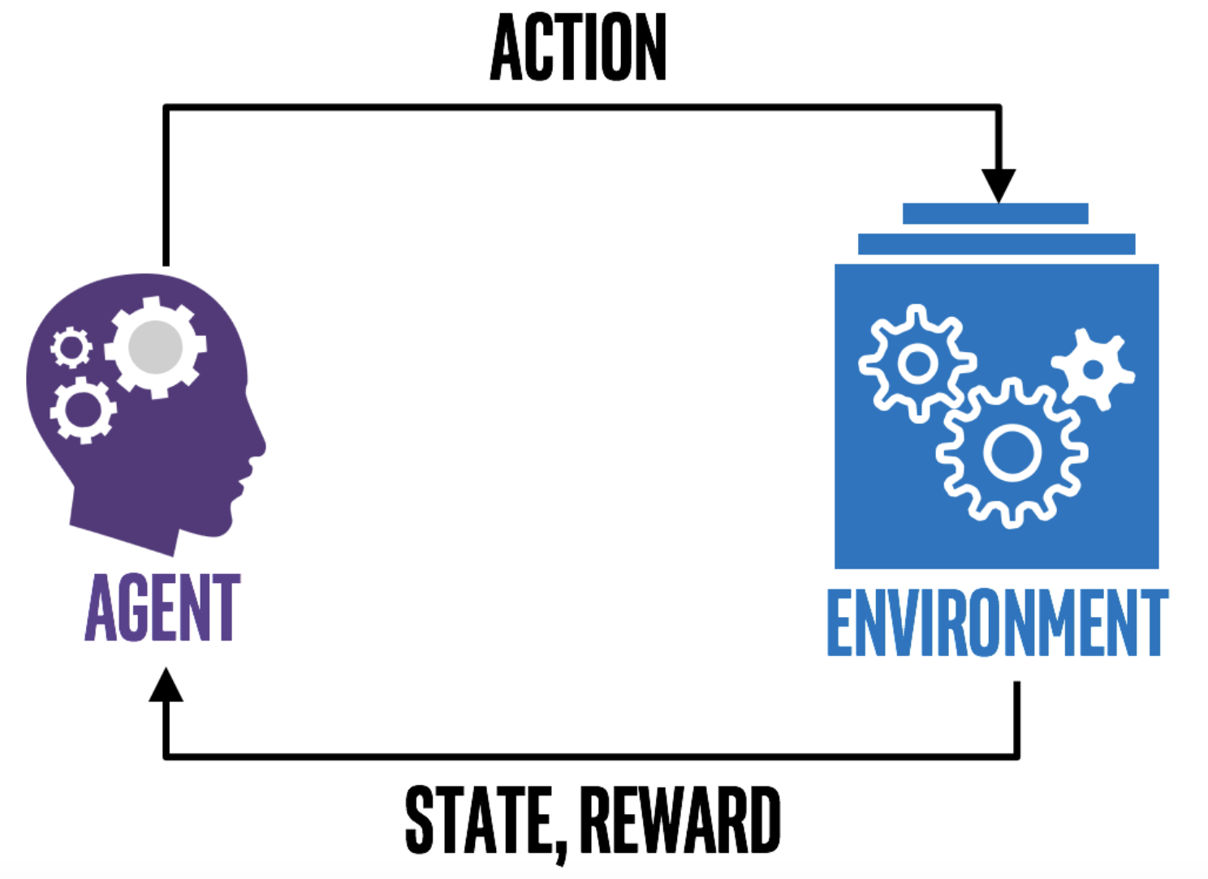
Reinforcement Learning Goal
The goal of Reinforcement Learning
To learn an optimal strategy for achieving a goal by experimental trials and relatively simple feedback. The agent actively adapts to an environment to maximize future rewards.

Slide 22
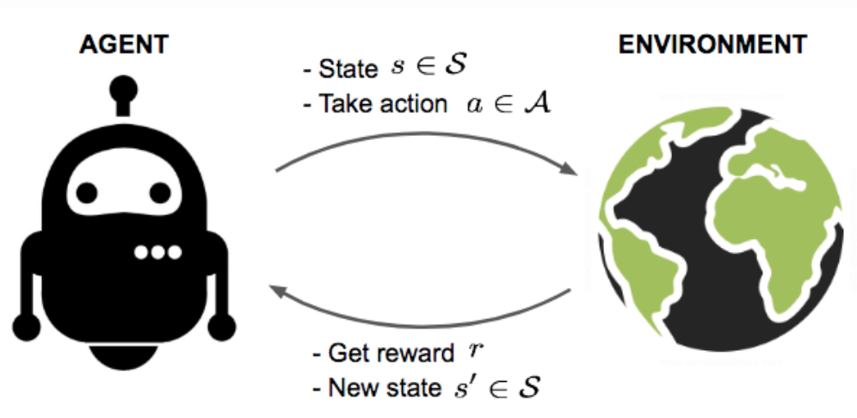
Key Concepts
Agent acts in an unknown Environment
Interaction with Environment gives Reward to Agent
An Agent can stay in one of many States of the Environment and choose to take one of many Actions
Which State the Agent will arrive in is decided by Transition Probabilities between the States

Slide 23
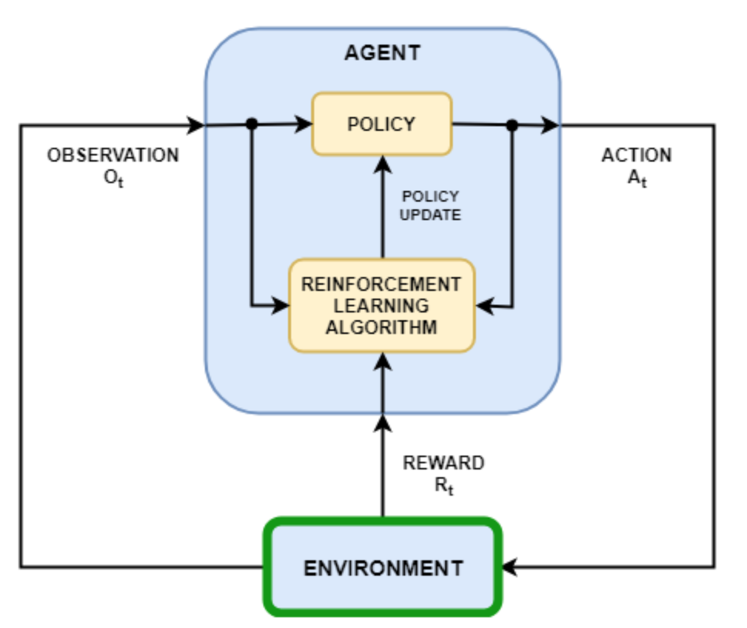
Key Concepts
Agent’s Policy provides a guideline on what is the optimal action to take in a particular State
The goal is to Maximize the Total Rewards
Each State is associated with a Value Function
A Value Function predicts the expected amount for future Rewards the Agent can receive starting in a particular State, by following the corresponding Policy
A Value Function quantifies how good a state is
Both Policies and Value Functions are what we try to learn in RL

Slide 24

Key Concept Examples
Chess Game
Problem | Win a Chess game
Environment | Chess Board
Agent | Player
Reward | Win or loose the game
States | Each possible board configuration
Actions | The set of all possible moves from a particular state, and for a particular player
Policy | Optimal move from a state
Value State | How good the board configuration is for the player, where the goal is to win the game
This table is a placeholder | Place your table over it

Slide 25
Key Concept Examples
Mobile Robot
Problem | Find the recharge station
Environment | The set of rooms to which the robot has access
Agent | Robot
Reward | Find the recharge station
States | Current charge level, position related to the recharge station
Actions | Right, Left, Ahead, Back
Policy | Optimal move from a state
Value State | The current charge level for the robot, where the goal is to find the recharge station
This table is a placeholder | Place your table over it

Slide 26
Elements of RL
Reward Signal
Defines the goal of a reinforcement learning problem
Reward signal determines the immediate, intrinsic desirability of environmental states
The agent’s sole objective is to maximize the total reward it receives over the long run
The reward signal is the primary basis for altering the policy
In general, reward signals may be stochastic functions of the state of the environment and the actions taken
Rewards are basically given directly by the environment

Slide 27
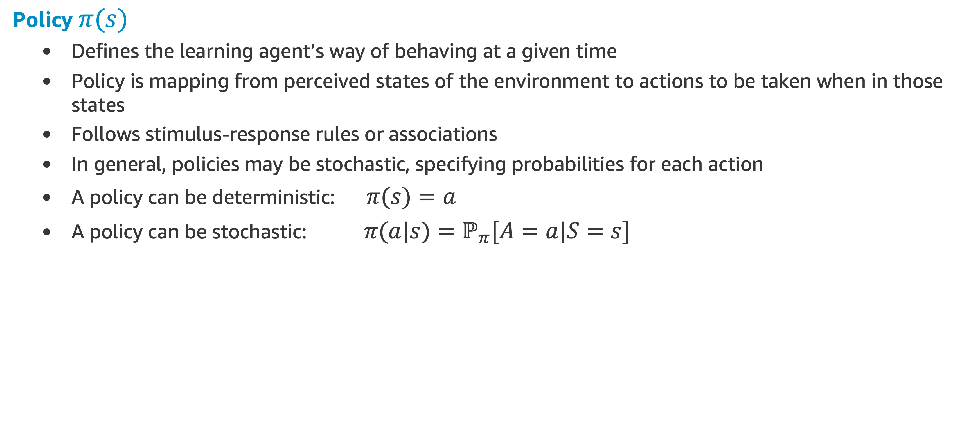
Elements of RL
Policy $π(s)$
Defines the learning agent’s way of behaving at a given time
Policy is mapping from perceived states of the environment to actions to be taken when in those states
Follows stimulus-response rules or associations
In general, policies may be stochastic, specifying probabilities for each action
A policy can be deterministic: $π(s)=a$
A policy can be stochastic: $π(a|s)=ℙ_{π}[A=a|S=s]$

Slide 28
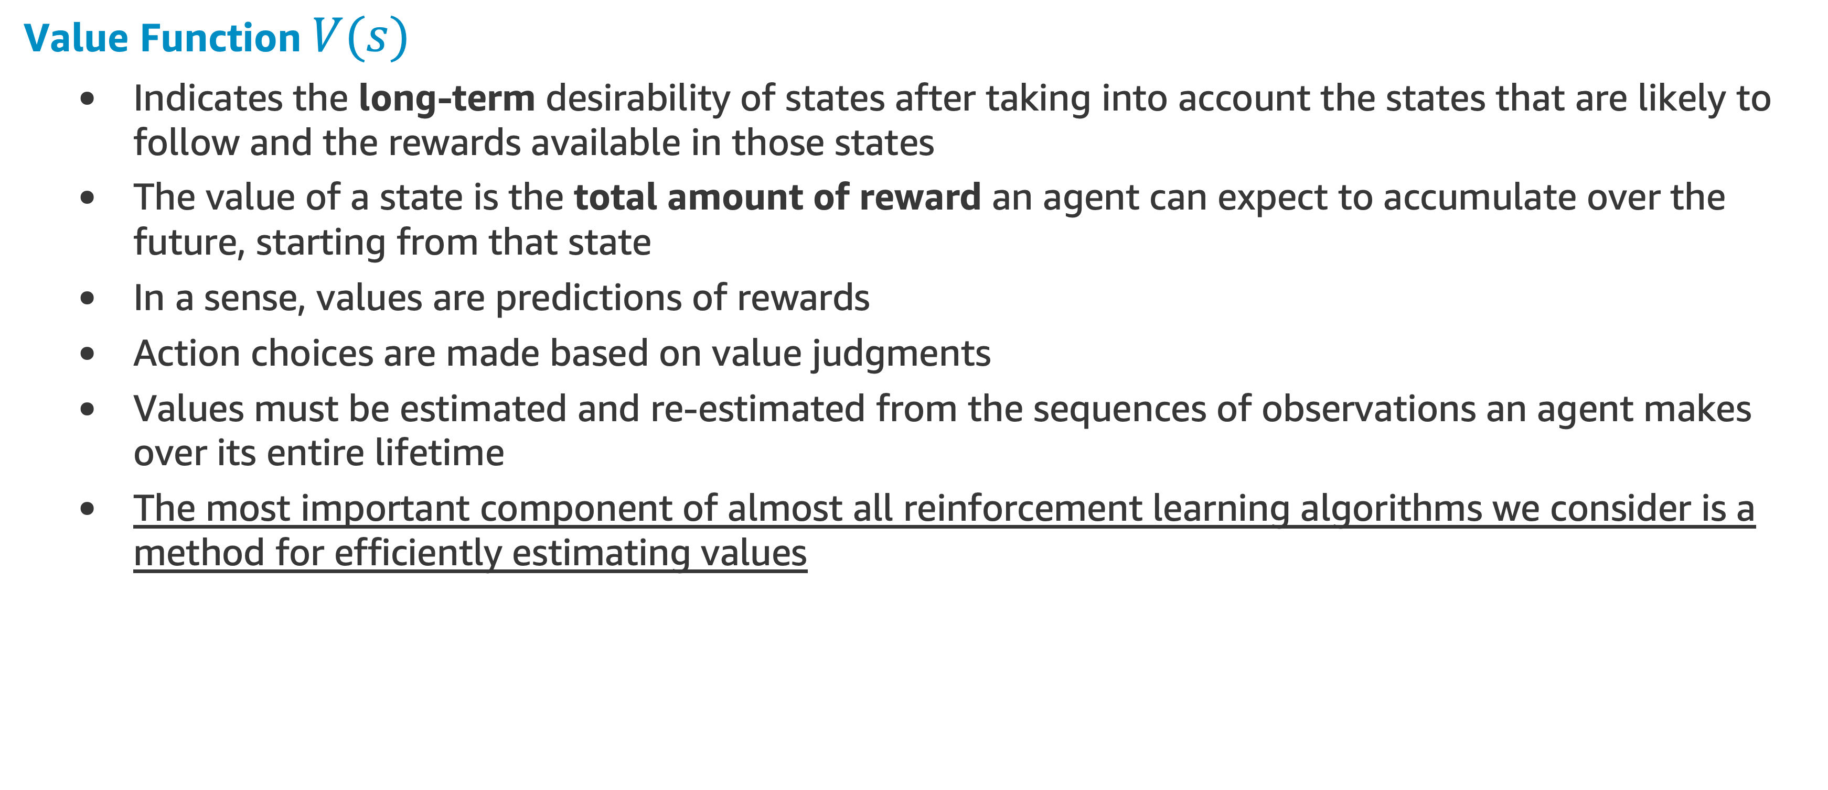
Elements of RL
Value Function $V(s)$
Indicates the long-term desirability of states after taking into account the states that are likely to follow and the rewards available in those states
The value of a state is the total amount of reward an agent can expect to accumulate over the future, starting from that state
In a sense, values are predictions of rewards
Action choices are made based on value judgments
Values must be estimated and re-estimated from the sequences of observations an agent makes over its entire lifetime
The most important component of almost all reinforcement learning algorithms we consider is a method for efficiently estimating values

Slide 29
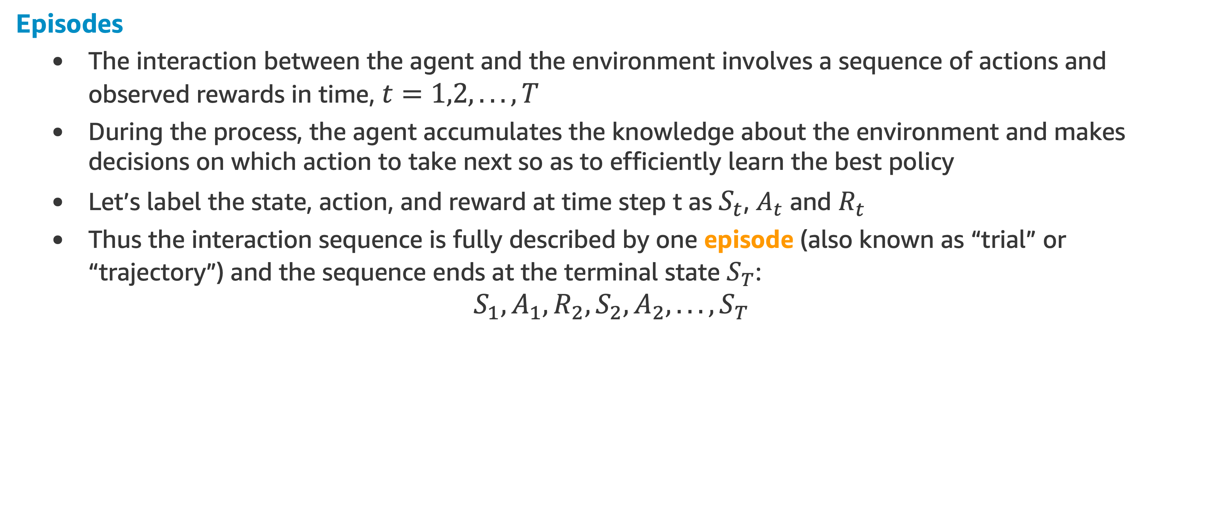
Elements of RL
Episodes
The interaction between the agent and the environment involves a sequence of actions and observed rewards in time, $t=1,2,...,T$
During the process, the agent accumulates the knowledge about the environment and makes decisions on which action to take next so as to efficiently learn the best policy
Let’s label the state, action, and reward at time step t as $S_{t}$, $A_{t}$ and $R_{t}$
Thus the interaction sequence is fully described by one episode (also known as “trial” or “trajectory”) and the sequence ends at the terminal state $S_{T}$:
$$S_{1},A_{1},R_{2},S_{2},A_{2},...,S_{T}$$

Slide 30
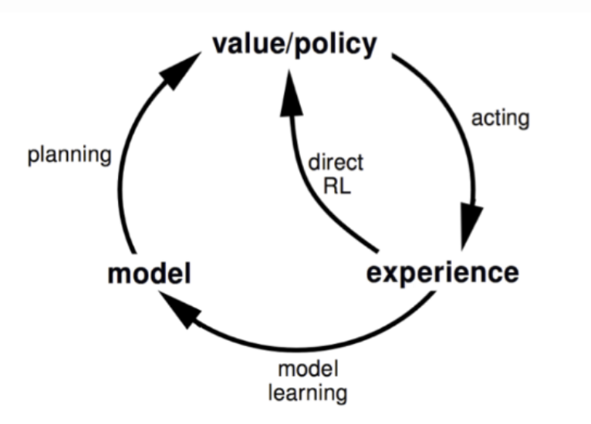
Elements of RL
Model
It mimics the behavior of the environment, or more generally, allows inferences to be made about how the environment will behave
Ex: Given a state and action, the model might predict the resultant next state and next reward
Models are used for planning, by which we mean any way of deciding on a course of action by considering possible future situations before they are actually experienced
A RL method can be model-based or model-free

Slide 31
Elements of RL
If we know the model
We can plan with perfect information
It is called model-based RL
We can find the optimal solution*
Rely on the model of the environment; either the model is known or the algorithm learns it explicitly
If we don’t know the model
We learn from incomplete information
It is model-free RL
No dependency on the model during learning
*Using Dynamic Programming (DP), discussed later in this module
NEXT TOPIC: Markov Chains

Slide 32
Markov Chains

Slide 33
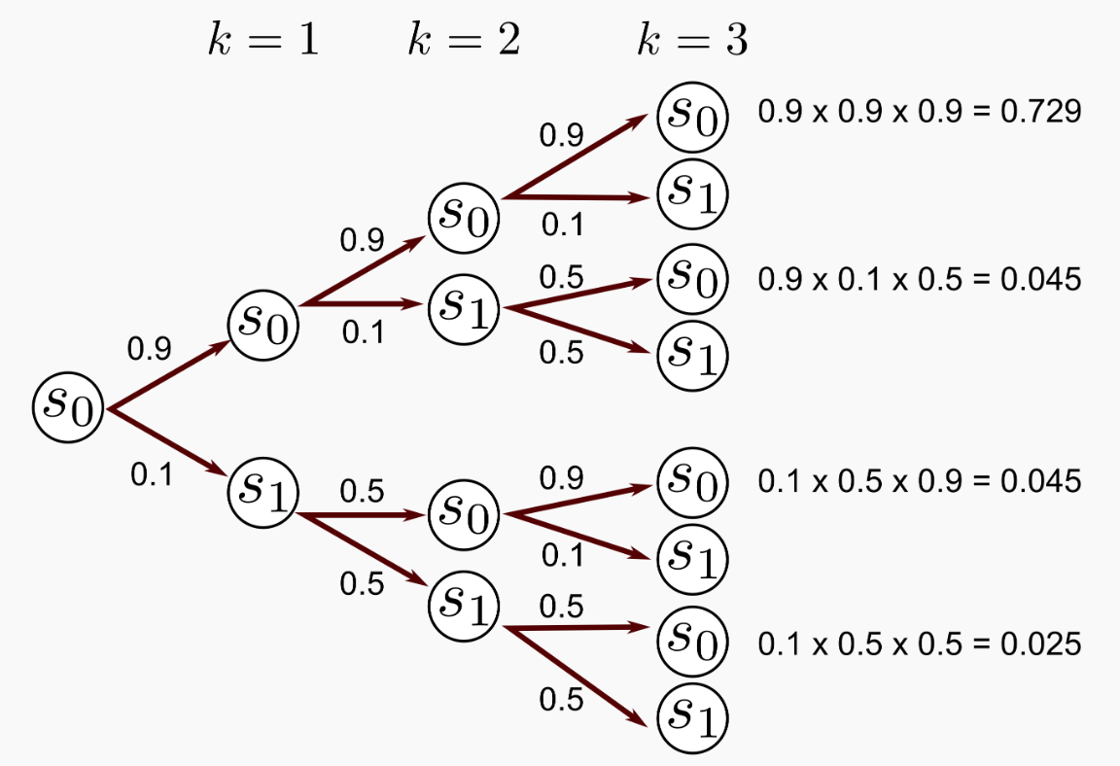
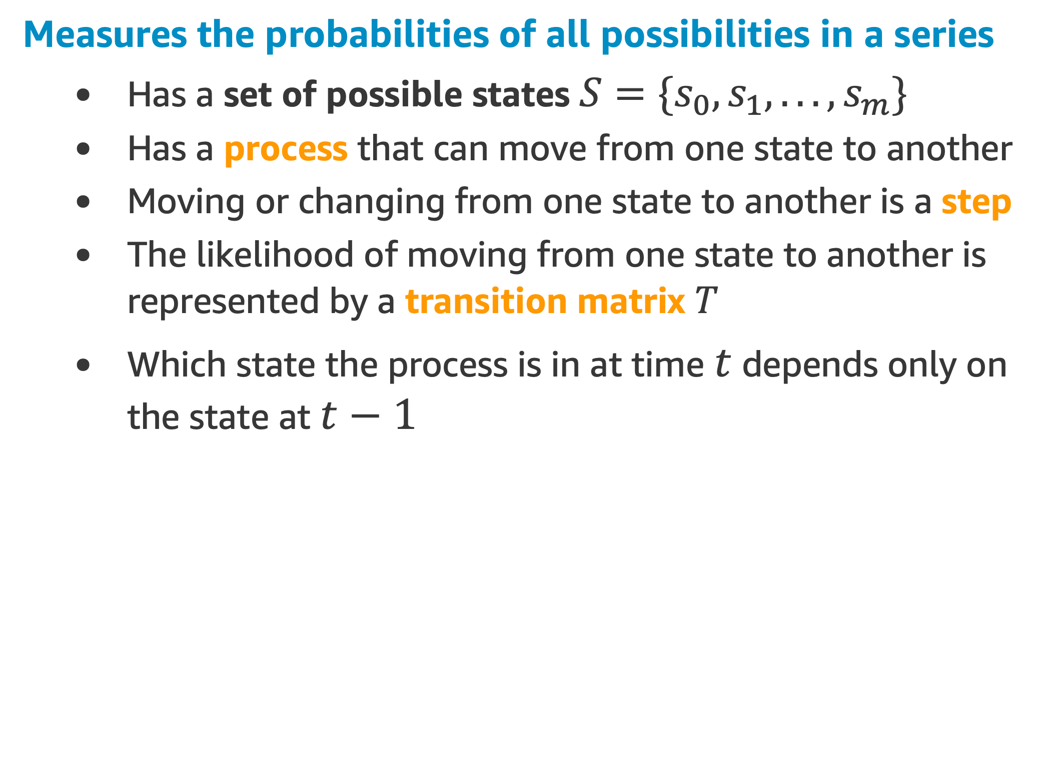
Markov Chain Description
Measures the probabilities of all possibilities in a series
Has a set of possible states $S=\{s_{0},s_{1},...,s_{m}\}$
Has a process that can move from one state to another
Moving or changing from one state to another is a step
The likelihood of moving from one state to another is represented by a transition matrix $T$
Which state the process is in at time $t$ depends only on the state at $t−1$
Initial

Slide 36
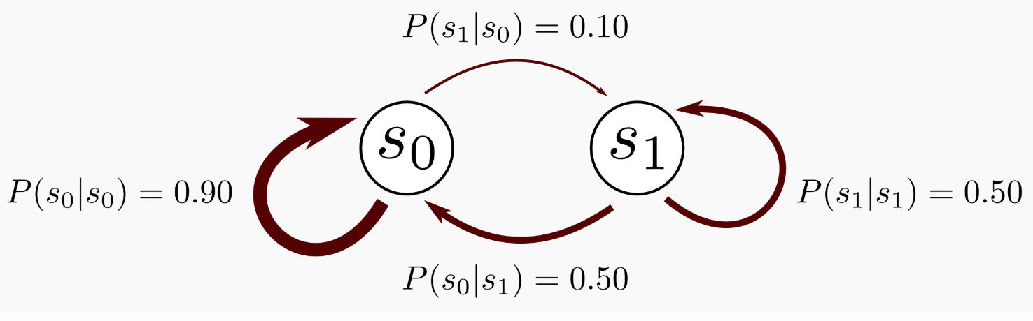
Example
We can graphically represent this Markov Chain:

Slide 37
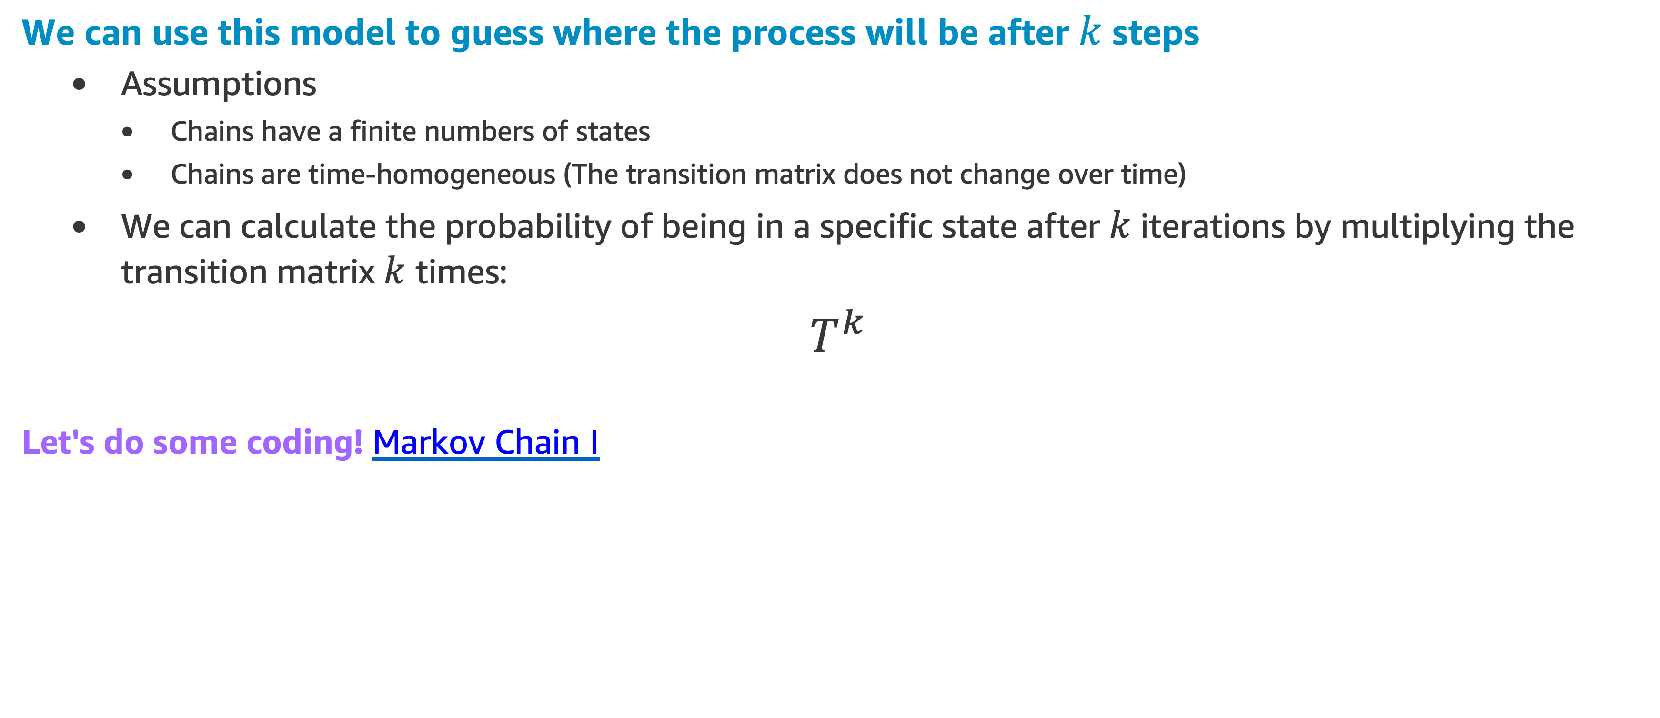
Example
We can use this model to guess where the process will be after $k$ steps
Assumptions
Chains have a finite numbers of states
Chains are time-homogeneous (The transition matrix does not change over time)
We can calculate the probability of being in a specific state after $k$ iterations by multiplying the transition matrix $k$ times:
$T^{k}$
Let's do some coding! Markov Chain I

Slide 38
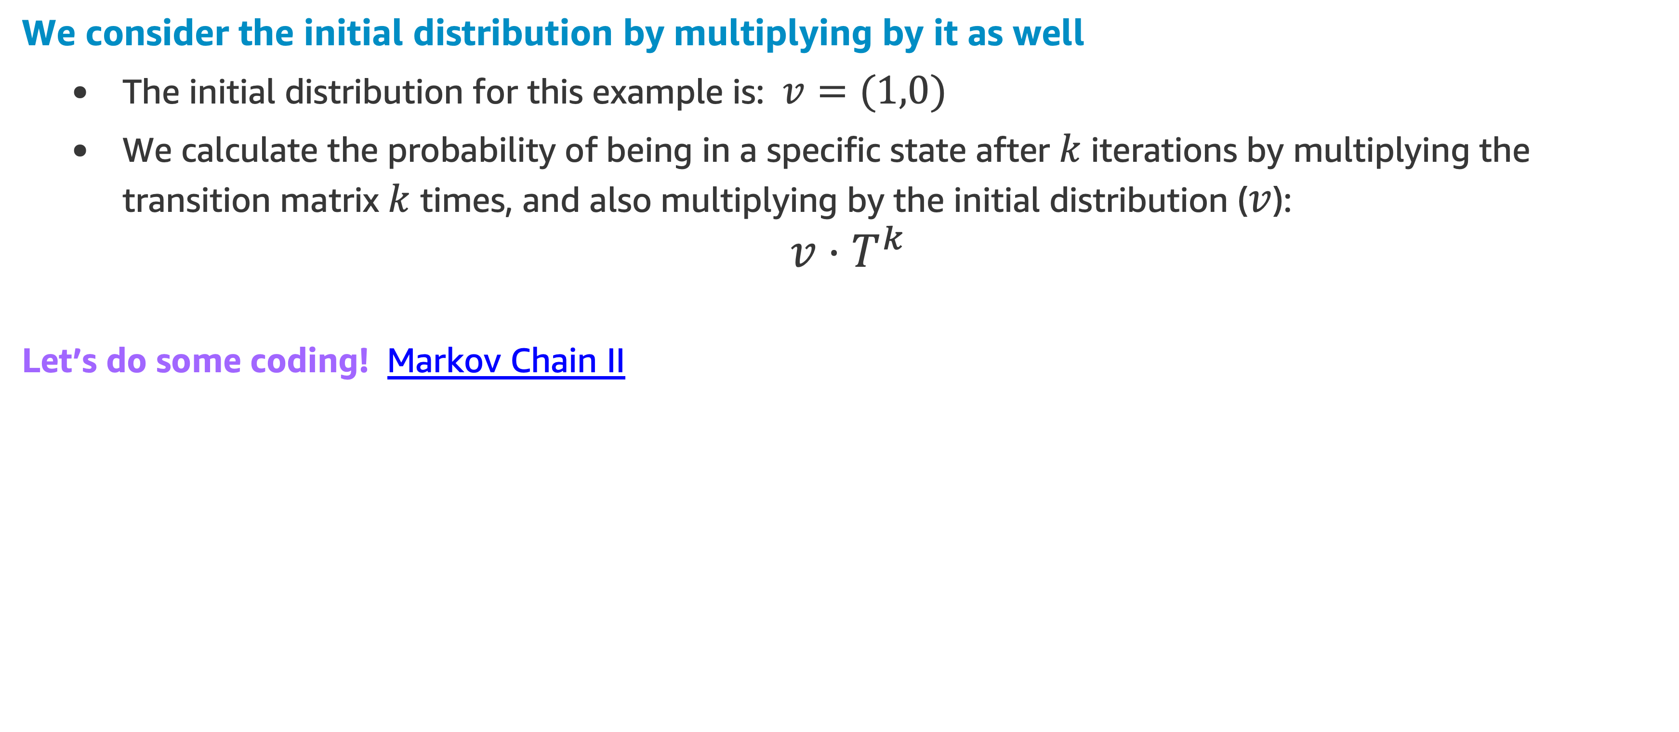
Example
We consider the initial distribution by multiplying by it as well
The initial distribution for this example is: $v=(1,0)$
We calculate the probability of being in a specific state after $k$ iterations by multiplying the transition matrix $k$ times, and also multiplying by the initial distribution ($v$):
$$v⋅T^{k}$$
Let’s do some coding! Markov Chain II

Slide 40
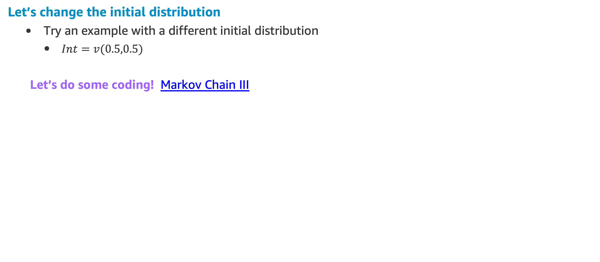
Example
Let’s change the initial distribution
Try an example with a different initial distribution
$Int=v(0.5,0.5)$
Let’s do some coding! Markov Chain III
Int
NEXT TOPIC: Markov Decision Process

Slide 41
Markov Decision Process

Slide 45
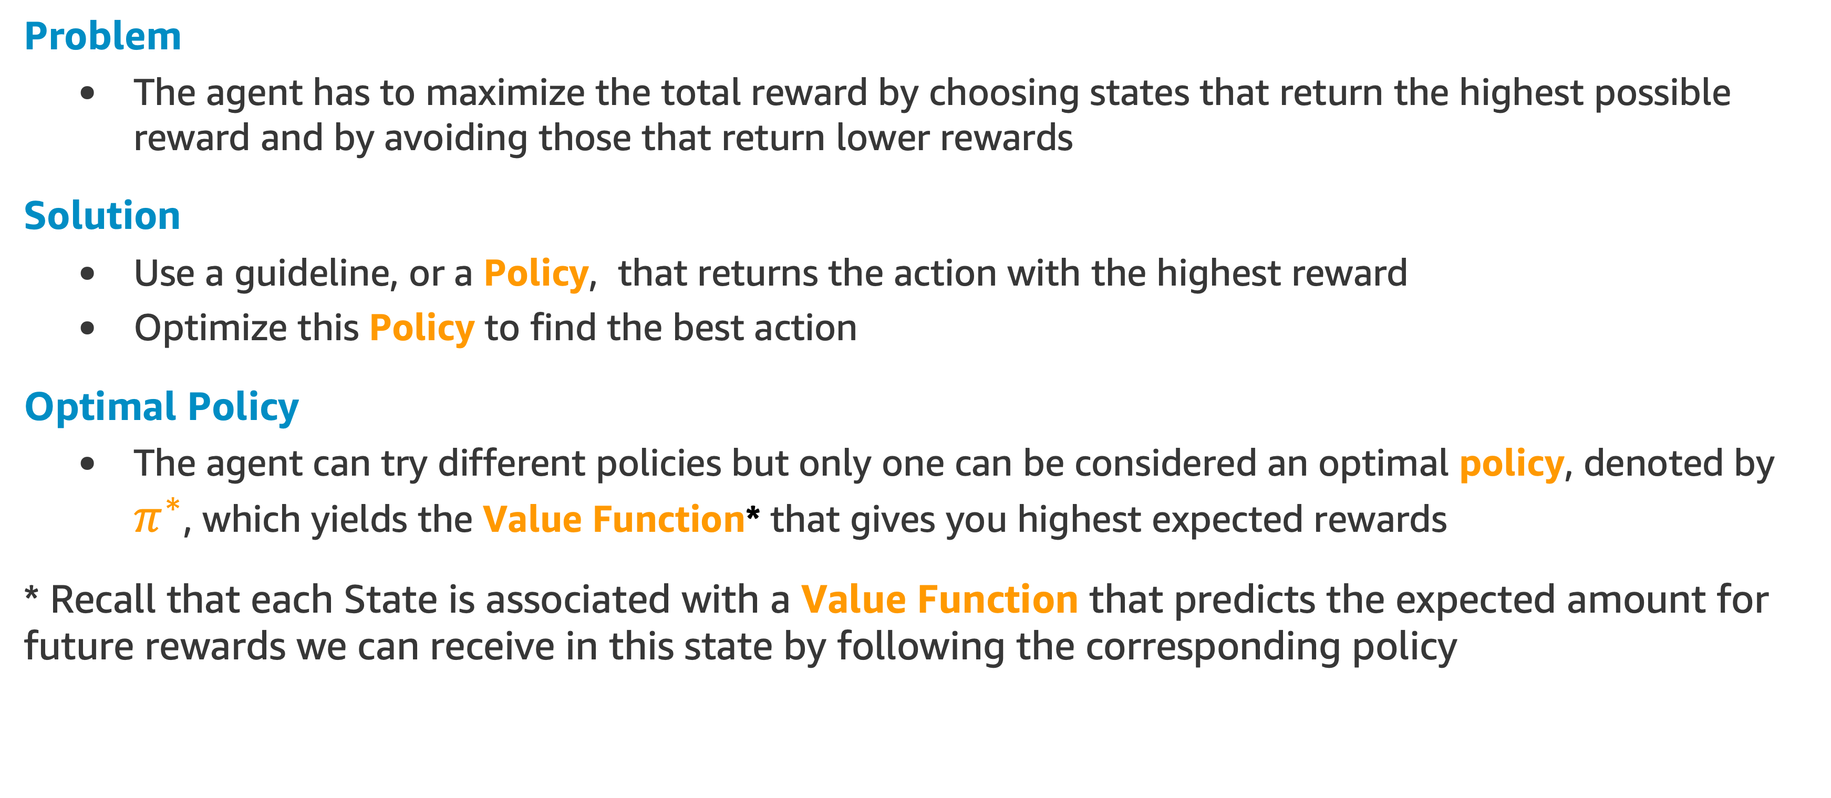
Optimize the Action in MDP
Problem
The agent has to maximize the total reward by choosing states that return the highest possible reward and by avoiding those that return lower rewards
Solution
Use a guideline, or a Policy, that returns the action with the highest reward
Optimize this Policy to find the best action
Optimal Policy
The agent can try different policies but only one can be considered an optimal policy, denoted by $π^{∗}$, which yields the Value Function* that gives you highest expected rewards
* Recall that each State is associated with a Value Function that predicts the expected amount for future rewards we can receive in this state by following the corresponding policy

Slide 46
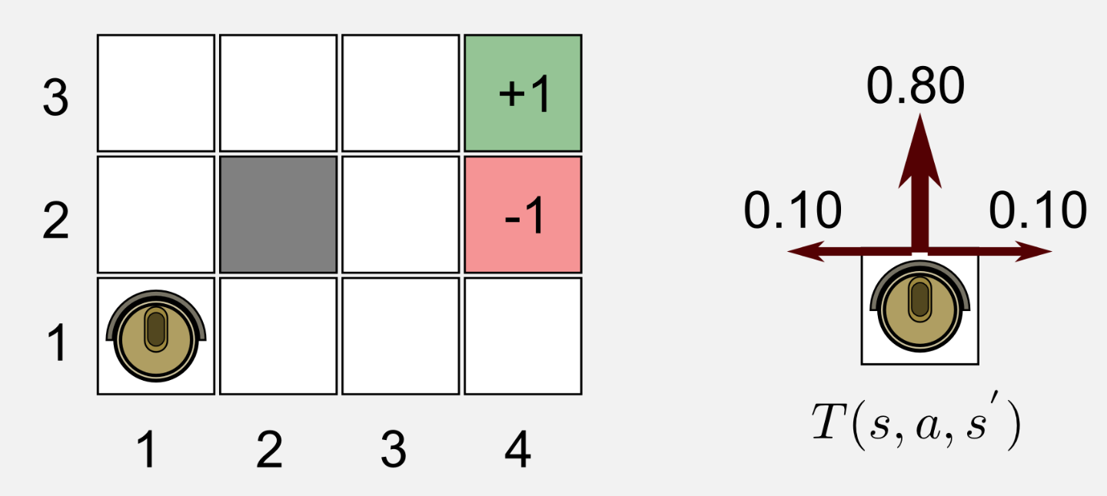
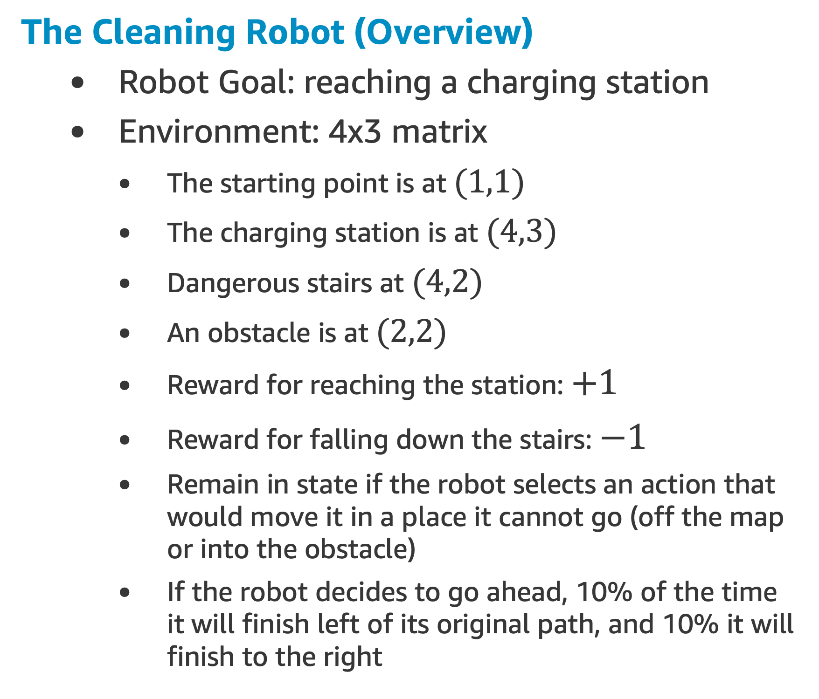
Markov Decision Process Example
The Cleaning Robot (Overview)
Robot Goal: reaching a charging station
Environment: 4x3 matrix
The starting point is at $(1,1)$
The charging station is at $(4,3)$
Dangerous stairs at $(4,2)$
An obstacle is at $(2,2)$
Reward for reaching the station: $+1$
Reward for falling down the stairs: $−1$
Remain in state if the robot selects an action that would move it in a place it cannot go (off the map or into the obstacle)
If the robot decides to go ahead, 10% of the time it will finish left of its original path, and 10% it will finish to the right
Reference: [1]

Slide 47
Markov Decision Process Example
The Cleaning Robot (Characteristics)
World Characteristics
Discrete time and space
Fully observable
The robot always knows which state it is in
Infinite horizon
There is not a fixed time limit
Known Transition Model

Slide 48
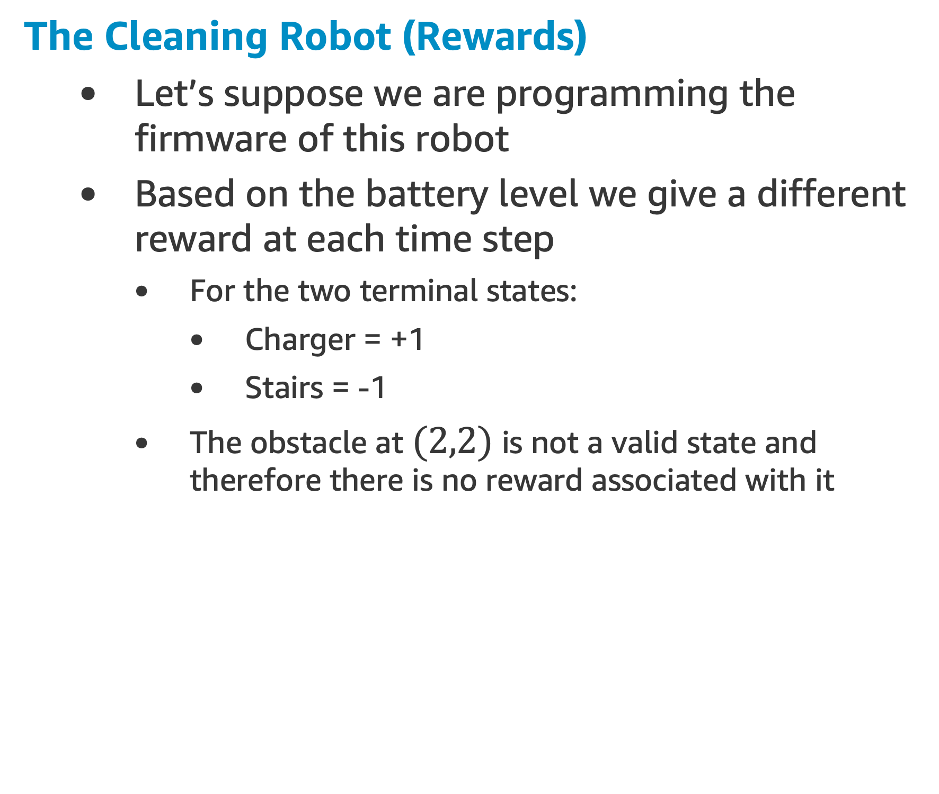
Markov Decision Process Example
The Cleaning Robot (Rewards)
Let’s suppose we are programming the firmware of this robot
Based on the battery level we give a different reward at each time step
For the two terminal states:
Charger = +1
Stairs = -1
The obstacle at $(2,2)$ is not a valid state and therefore there is no reward associated with it

Slide 49
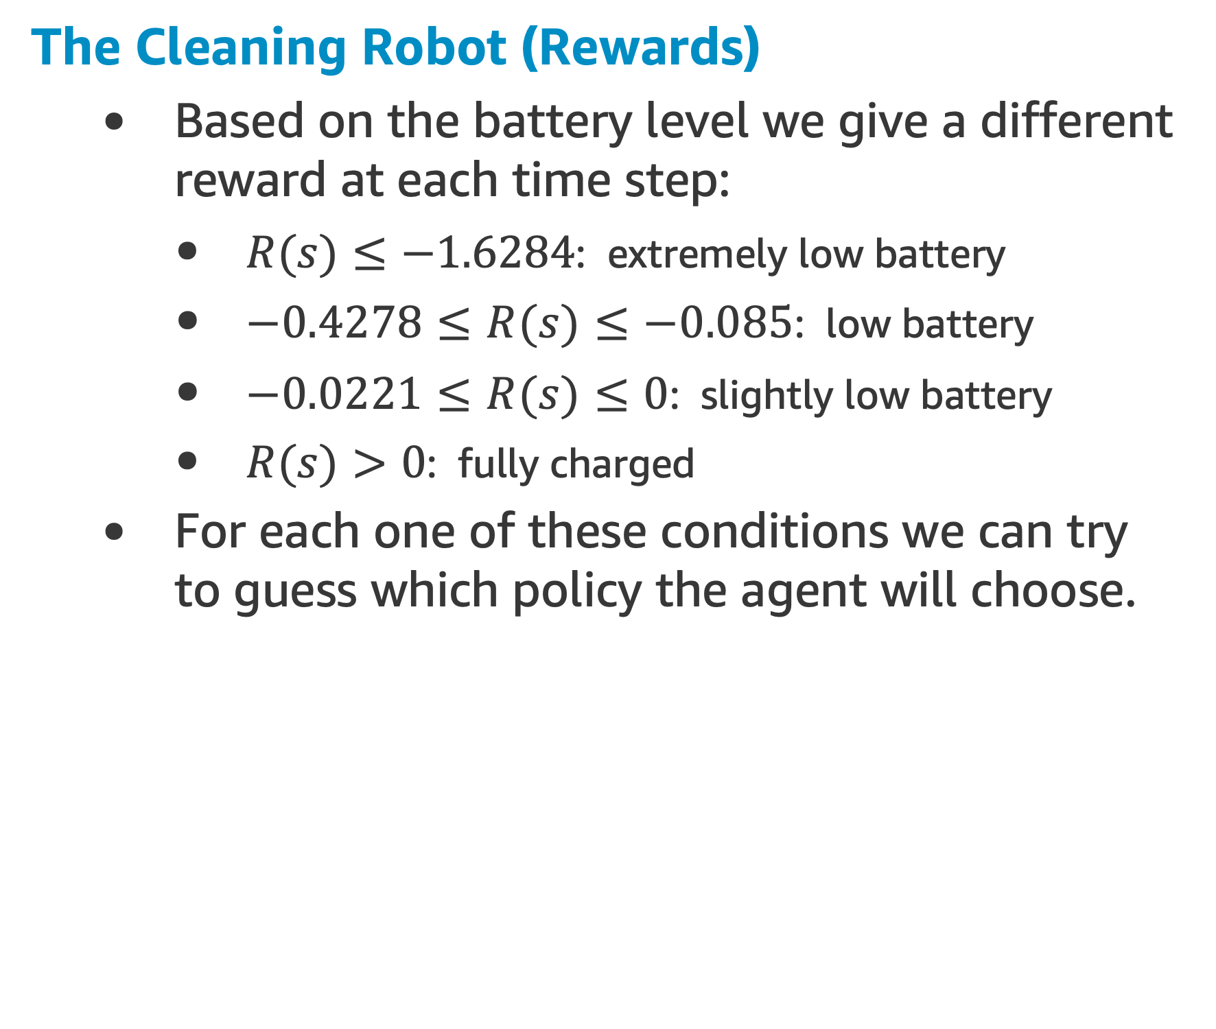
Markov Decision Process Example
The Cleaning Robot (Rewards)
Based on the battery level we give a different reward at each time step:
$R(s)≤−1.6284$: extremely low battery
$−0.4278≤R(s)≤−0.085$: low battery
$−0.0221≤R(s)≤0$: slightly low battery
$R(s)>0$: fully charged
For each one of these conditions we can try to guess which policy the agent will choose.

Slide 50
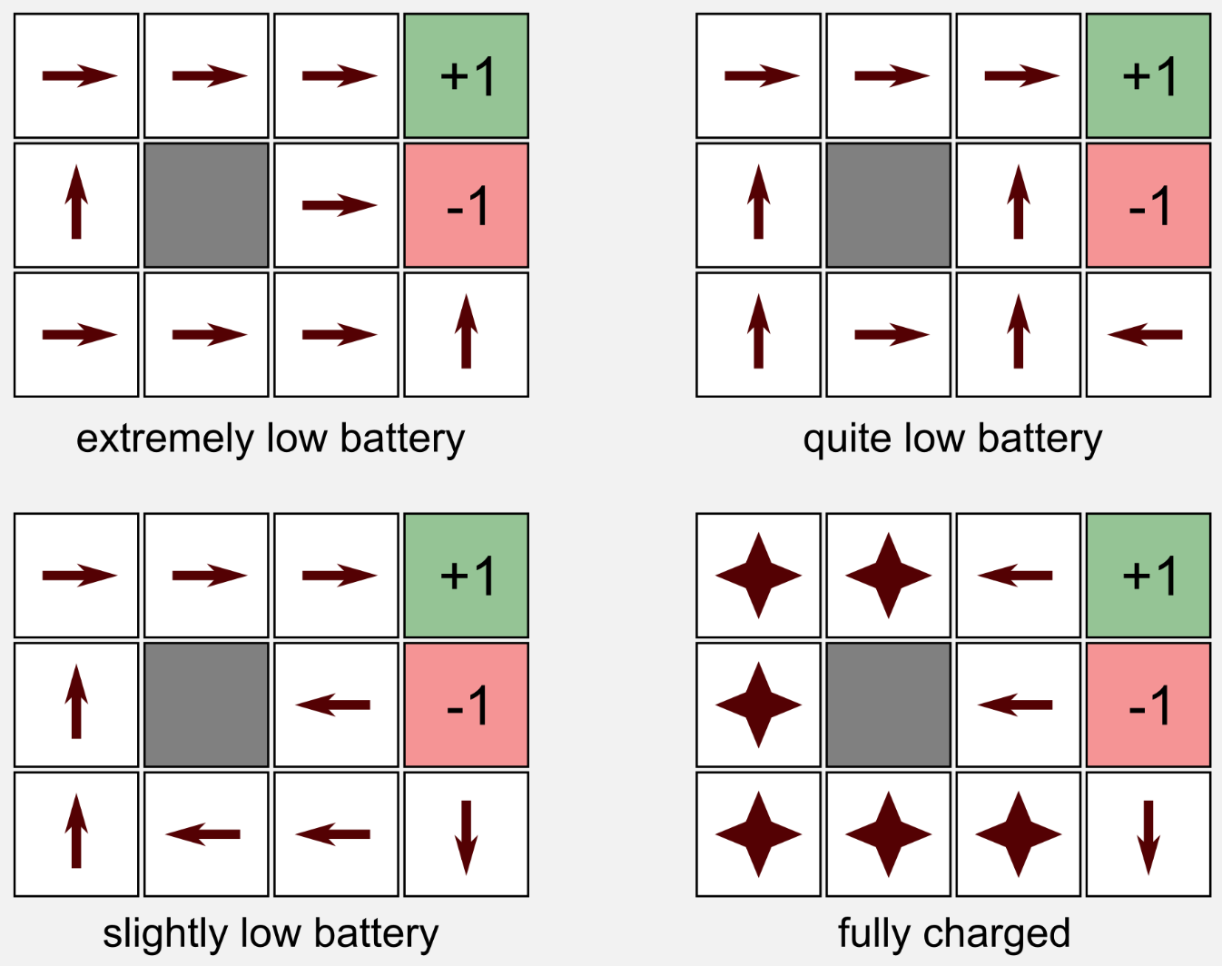
Markov Decision Process Example
Extremely low battery scenario
Punishment is so high that the agent only wants to stop the pain as soon as possible. Falling down the flight of stairs is a good choice.
Quite low battery scenario
The agent takes the shortest path to the charging station, it does not care about falling down.
Slightly low battery scenario
The robot does not take risks at all, avoiding the stairs at cost of banging against the wall.
Fully charged battery scenario
The agent avoids both the exits and remain in a steady state receiving a positive reward at each time step.
NEXT TOPIC: Bellman Equations

Slide 51
Bellman Equations

Slide 52
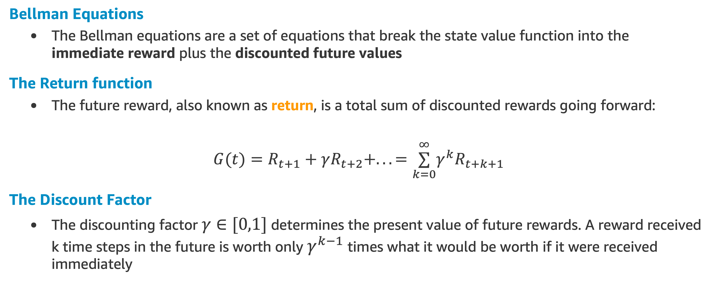
Bellman Equations
Bellman Equations
The Bellman equations are a set of equations that break the state value function into the immediate reward plus the discounted future values
The Return function
The future reward, also known as return, is a total sum of discounted rewards going forward:
$G(t)=R_{t+1}+γR_{t+2}+...=\overset{∞}{\underset{k=0}{∑}}γ^{k}R_{t+k+1}$
The Discount Factor
The discounting factor $γ∈[0,1]$ determines the present value of future rewards. A reward received k time steps in the future is worth only $γ^{k−1}$ times what it would be worth if it were received immediately

Slide 53
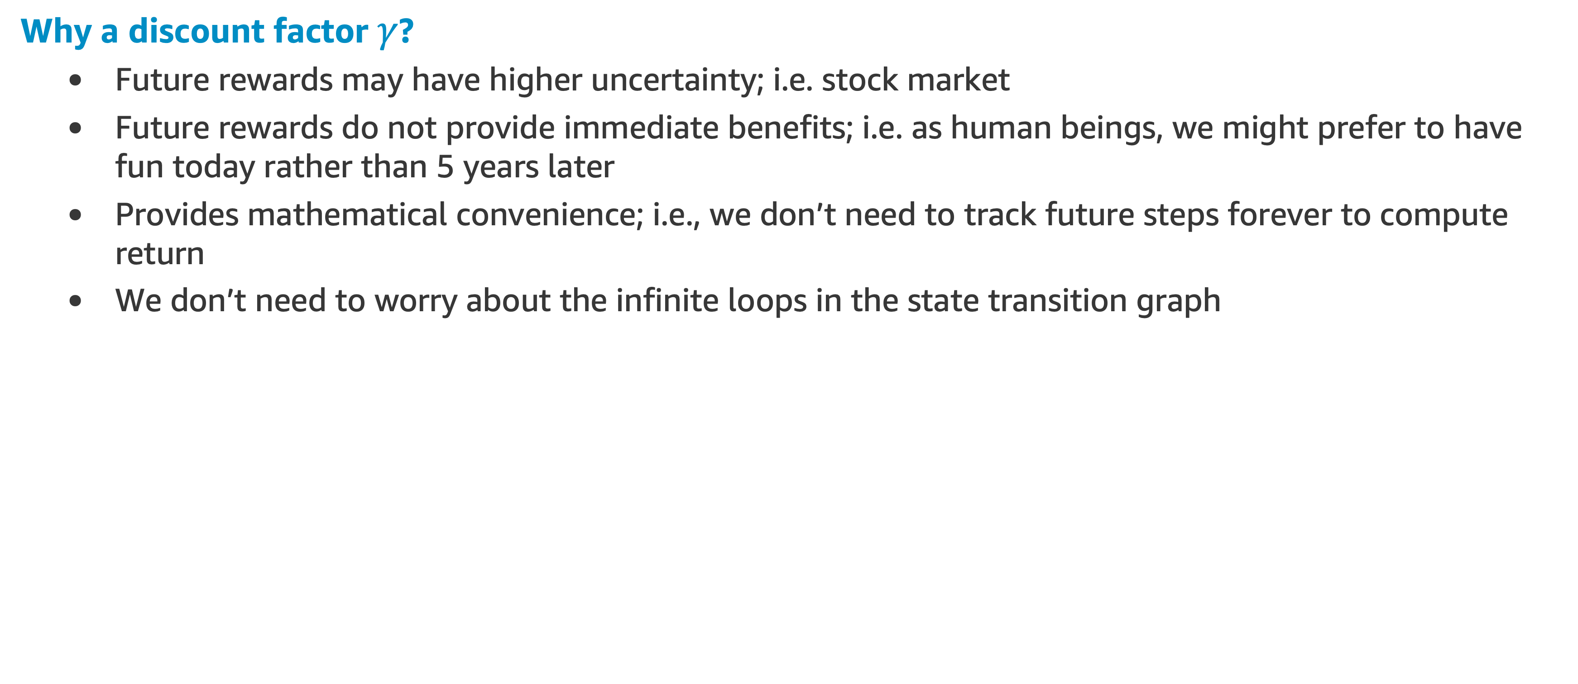
Bellman Equations
Why a discount factor $γ$?
Future rewards may have higher uncertainty; i.e. stock market
Future rewards do not provide immediate benefits; i.e. as human beings, we might prefer to have fun today rather than 5 years later
Provides mathematical convenience; i.e., we don’t need to track future steps forever to compute return
We don’t need to worry about the infinite loops in the state transition graph

Slide 54
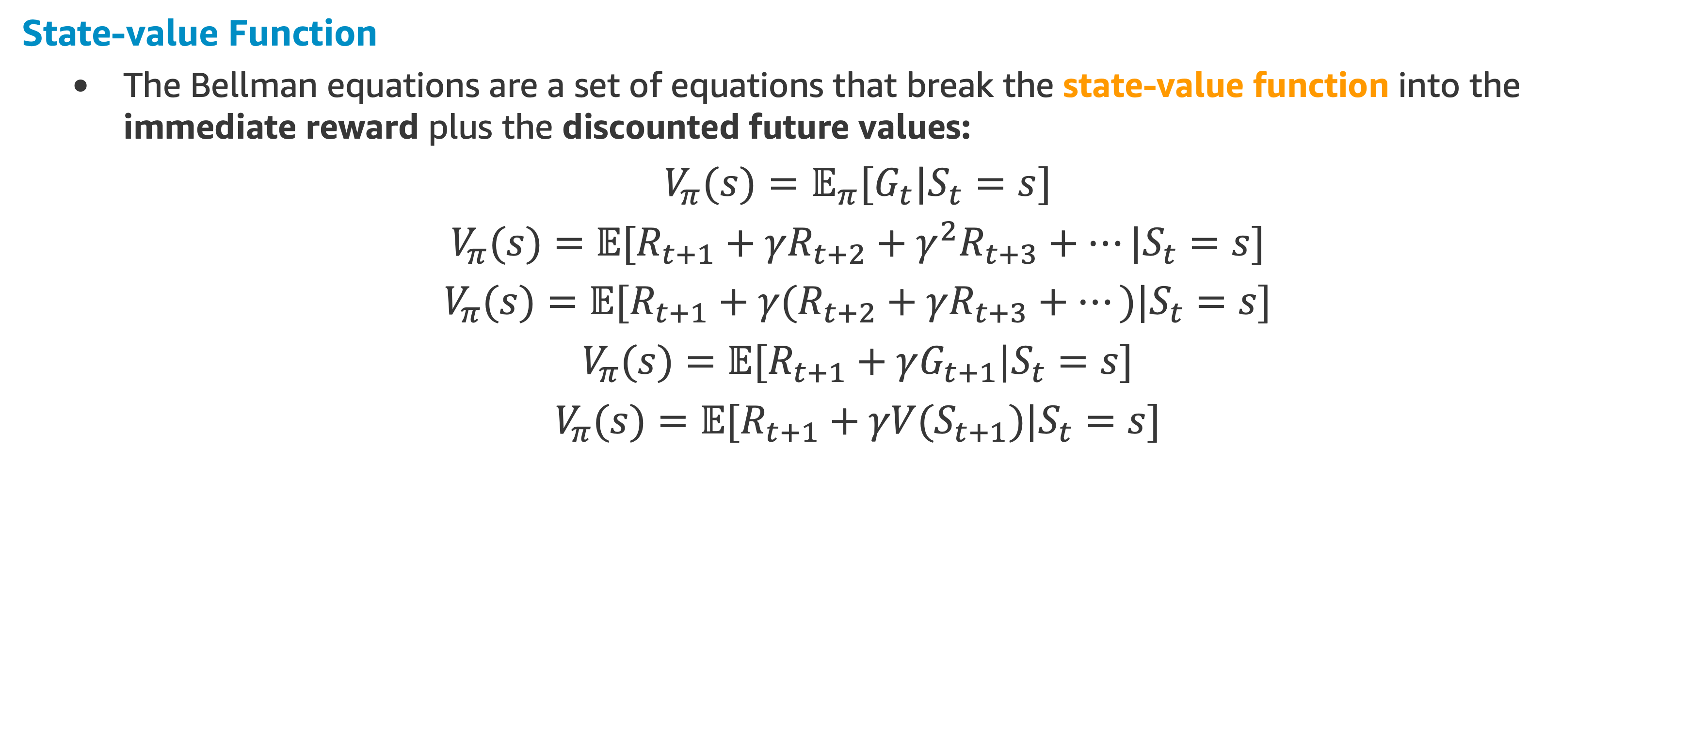
Bellman Equations
State-value Function
The Bellman equations are a set of equations that break the state-value function into the immediate reward plus the discounted future values:
$V_{π}(s)=𝔼_{π}[G_{t}|S_{t}=s]$
$V_{π}(s)=𝔼[R_{t+1}+γR_{t+2}+γ^{2}R_{t+3}+…|S_{t}=s]$
$V_{π}(s)=𝔼[R_{t+1}+γ(R_{t+2}+γR_{t+3}+…)|S_{t}=s]$
$V_{π}(s)=𝔼[R_{t+1}+γG_{t+1}|S_{t}=s]$
$V_{π}(s)=𝔼[R_{t+1}+γV(S_{t+1})|S_{t}=s]$

Slide 55
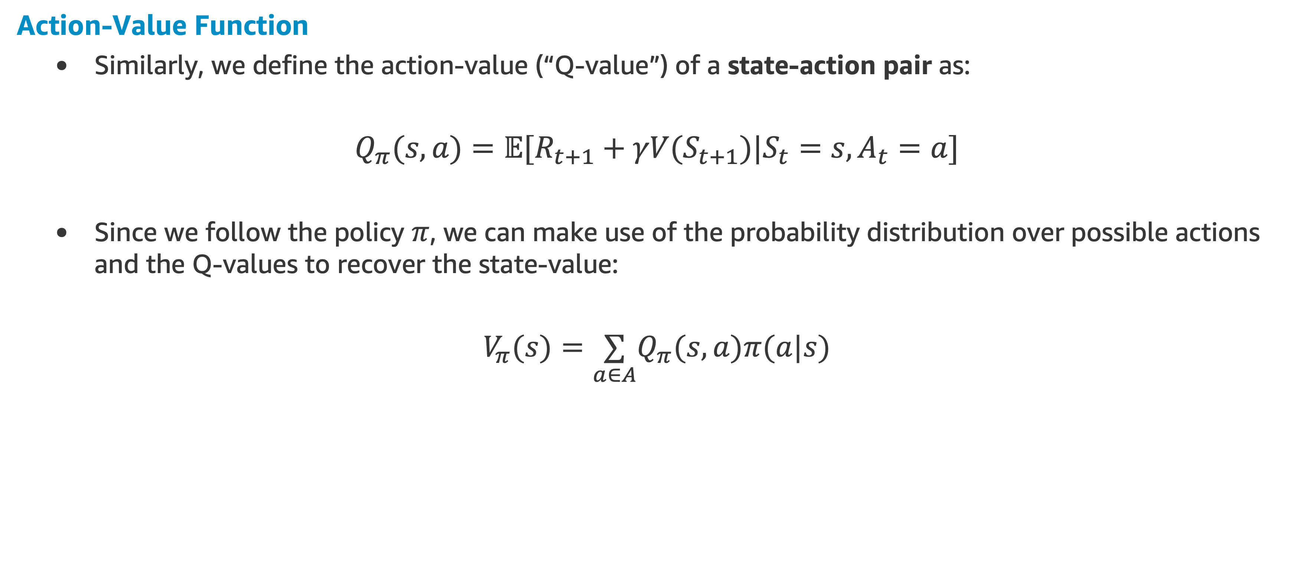
Bellman Equations
Action-Value Function
Similarly, we define the action-value (“Q-value”) of a state-action pair as:
$Q_{π}(s,a)=𝔼[R_{t+1}+γV(S_{t+1})|S_{t}=s,A_{t}=a]$
Since we follow the policy $π$, we can make use of the probability distribution over possible actions and the Q-values to recover the state-value:
$V_{π}(s)=\underset{a∈A}{∑}Q_{π}(s,a)π(a|s)$

Slide 56
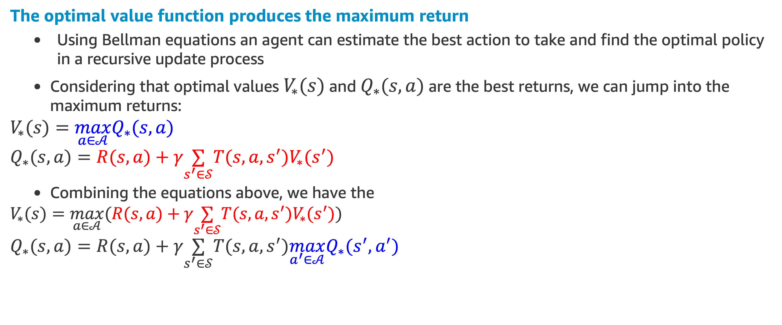
Bellman Optimality Equations
The optimal value function produces the maximum return
Using Bellman equations an agent can estimate the best action to take and find the optimal policy in a recursive update process
Considering that optimal values $V_{∗}(s)$ and $Q_{∗}(s,a)$ are the best returns, we can jump into the maximum returns:
$$V_{∗}(s)=\max_{a∈𝒜}Q_{∗}(s,a)$$
$$Q_{∗}(s,a)=R(s,a)+γ\underset{s^{′}∈𝒮}{∑}T(s,a,s^{′})V_{∗}(s^{′})$$
Combining the equations above, we have the
$$V_{∗}(s)=\max_{a∈𝒜}(R(s,a)+γ\underset{s^{′}∈𝒮}{∑}T(s,a,s^{′})V_{∗}(s^{′}))$$
$$Q_{∗}(s,a)=R(s,a)+γ\underset{s^{′}∈𝒮}{∑}T(s,a,s^{′})\max_{a^{′}∈𝒜}Q_{∗}(s^{′},a^{′})$$

Slide 57
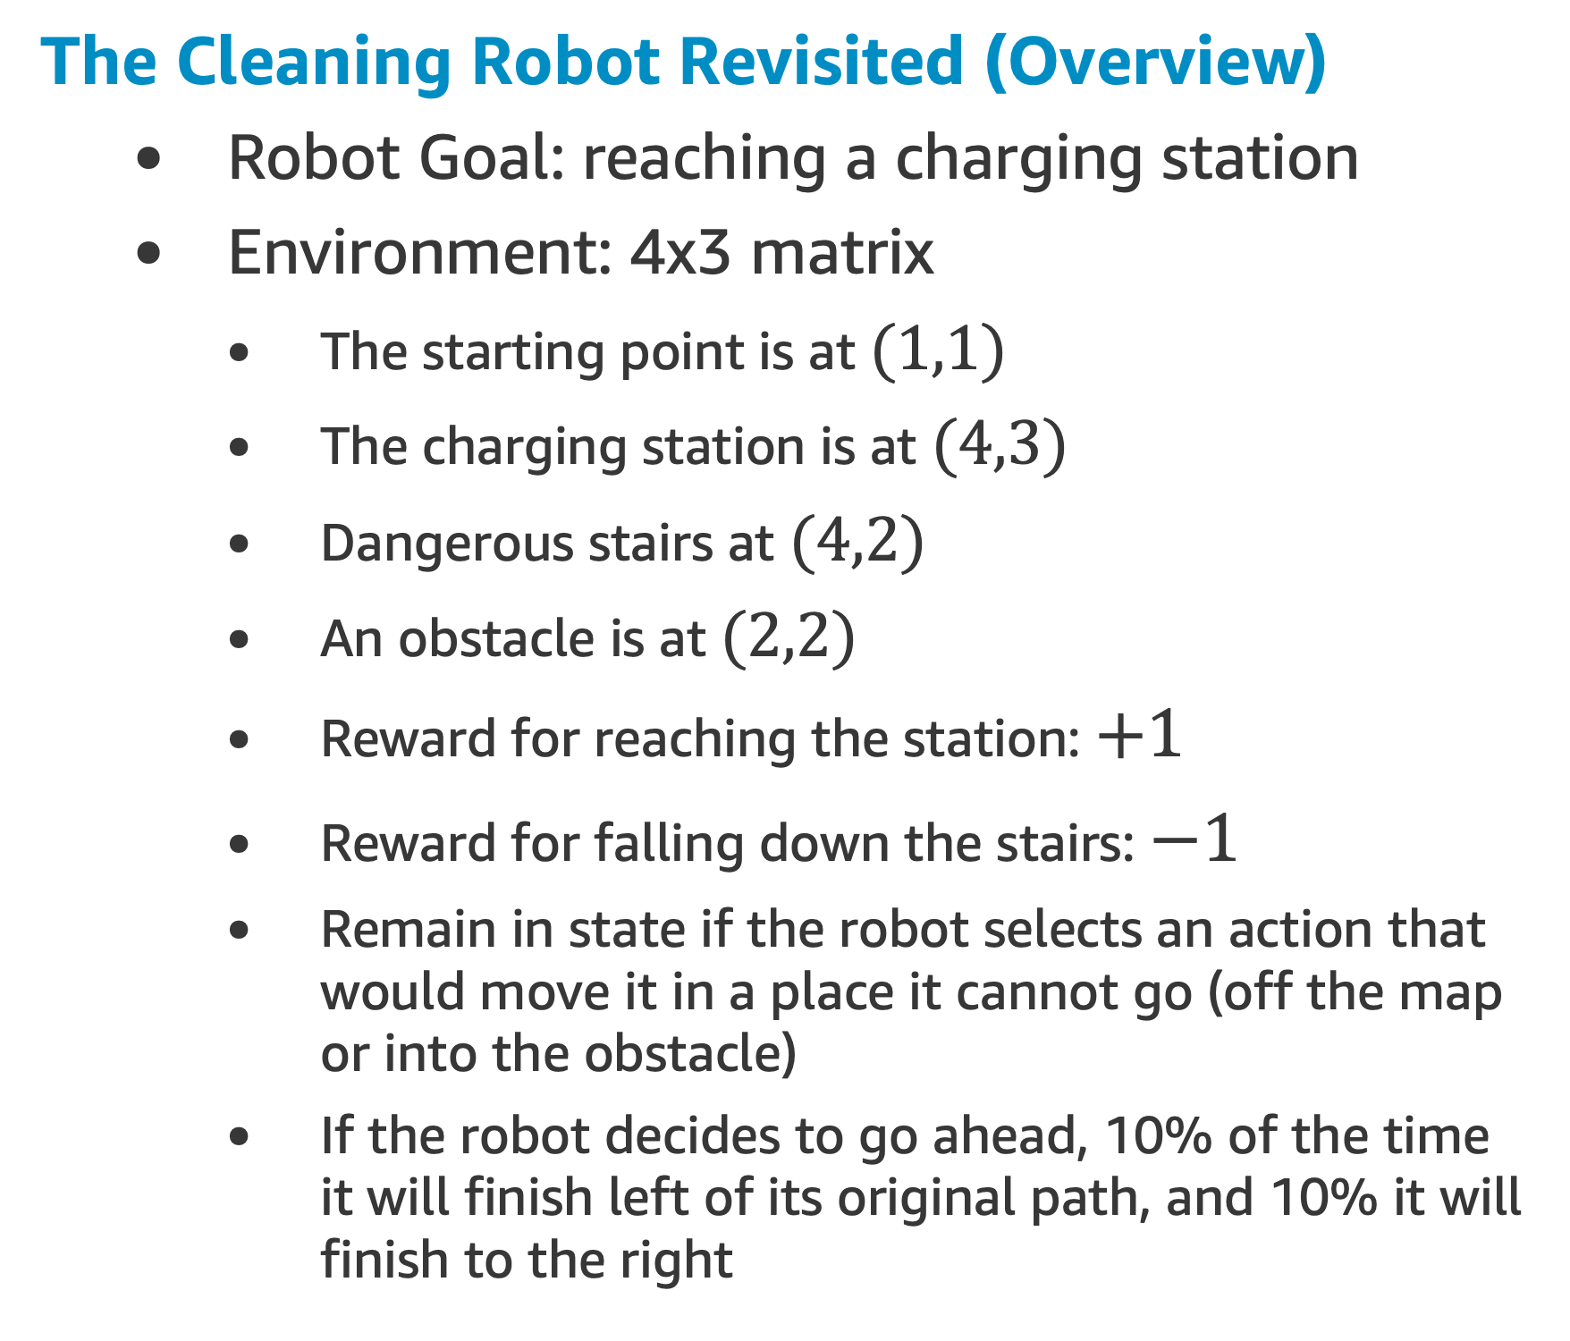
Bellman Equation Example
The Cleaning Robot Revisited (Overview)
Robot Goal: reaching a charging station
Environment: 4x3 matrix
The starting point is at $(1,1)$
The charging station is at $(4,3)$
Dangerous stairs at $(4,2)$
An obstacle is at $(2,2)$
Reward for reaching the station: $+1$
Reward for falling down the stairs: $−1$
Remain in state if the robot selects an action that would move it in a place it cannot go (off the map or into the obstacle)
If the robot decides to go ahead, 10% of the time it will finish left of its original path, and 10% it will finish to the right
Reference: [1]

Slide 58
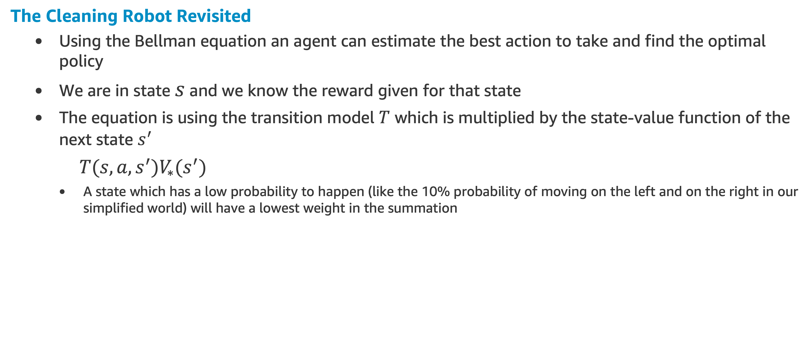
Bellman Equation Example
The Cleaning Robot Revisited
Using the Bellman equation an agent can estimate the best action to take and find the optimal policy
We are in state $s$ and we know the reward given for that state
The equation is using the transition model $T$ which is multiplied by the state-value function of the next state $s^{′}$
$T(s,a,s^{′})V_{∗}(s^{′})$
A state which has a low probability to happen (like the 10% probability of moving on the left and on the right in our simplified world) will have a lowest weight in the summation

Slide 59
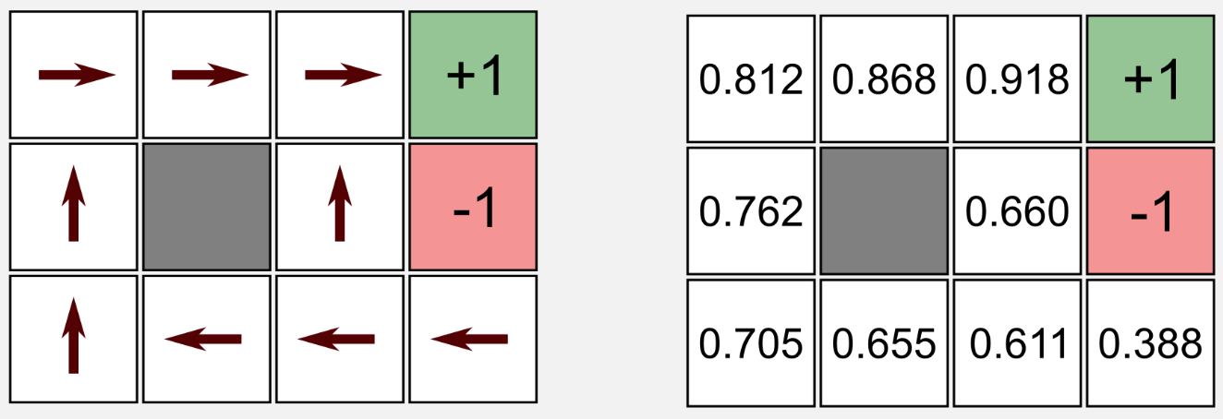
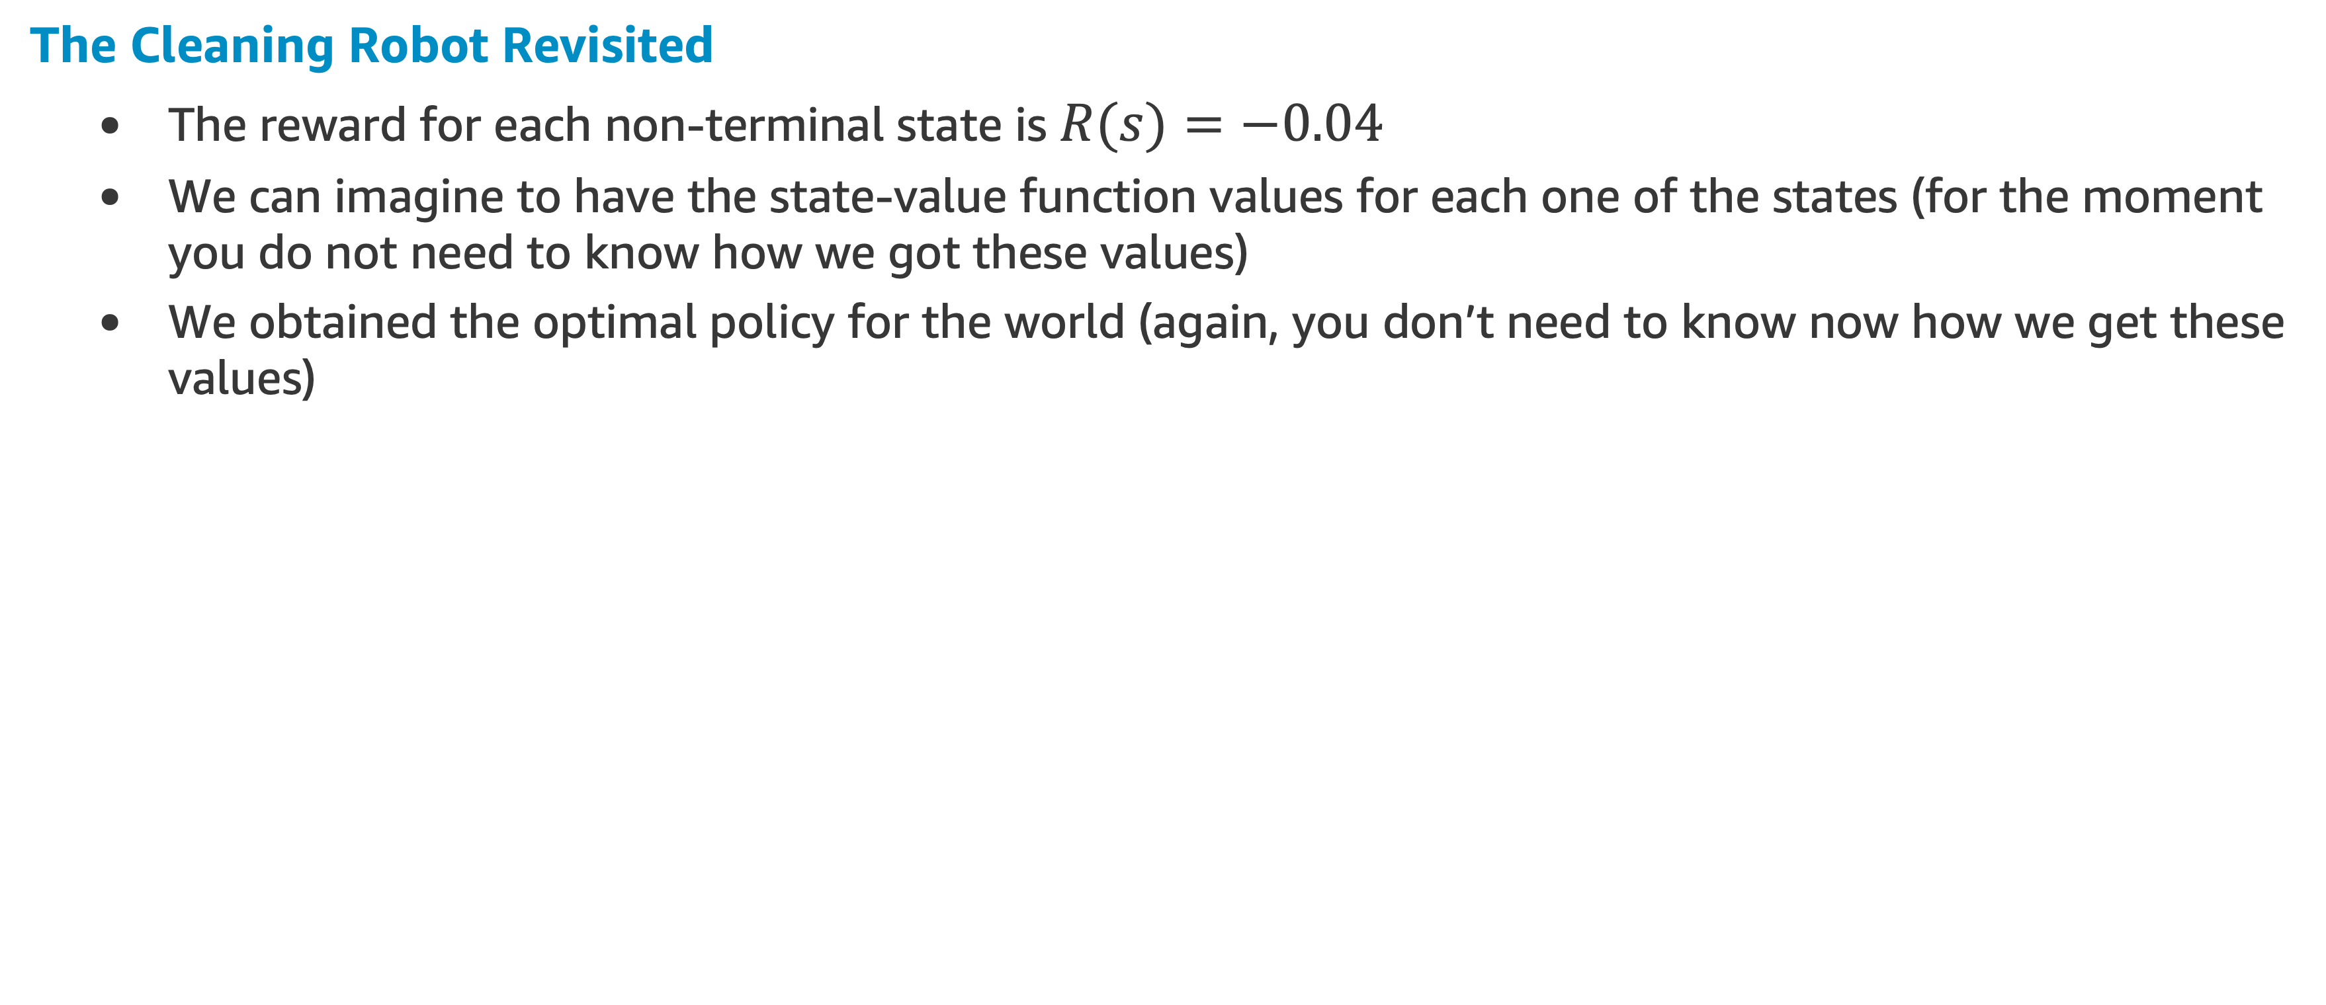
Bellman Equation Example
The Cleaning Robot Revisited
The reward for each non-terminal state is $R(s)=−0.04$
We can imagine to have the state-value function values for each one of the states (for the moment you do not need to know how we got these values)
We obtained the optimal policy for the world (again, you don’t need to know now how we get these values)
optimal policy
state-values

Slide 60
Bellman Equation Example
The Cleaning Robot Revisited
The robot starts from the state (1,1)
Using the Bellman equation we have to find which is the action with the highest utility between UP, LEFT, DOWN and RIGHT
We do not have the optimal policy, but we have the transition model and the utility values for each state
If the robot bounce on the wall it goes back to the previous state
The selected action is executed only with a probability of 80% in accordance with the transition model

Slide 61
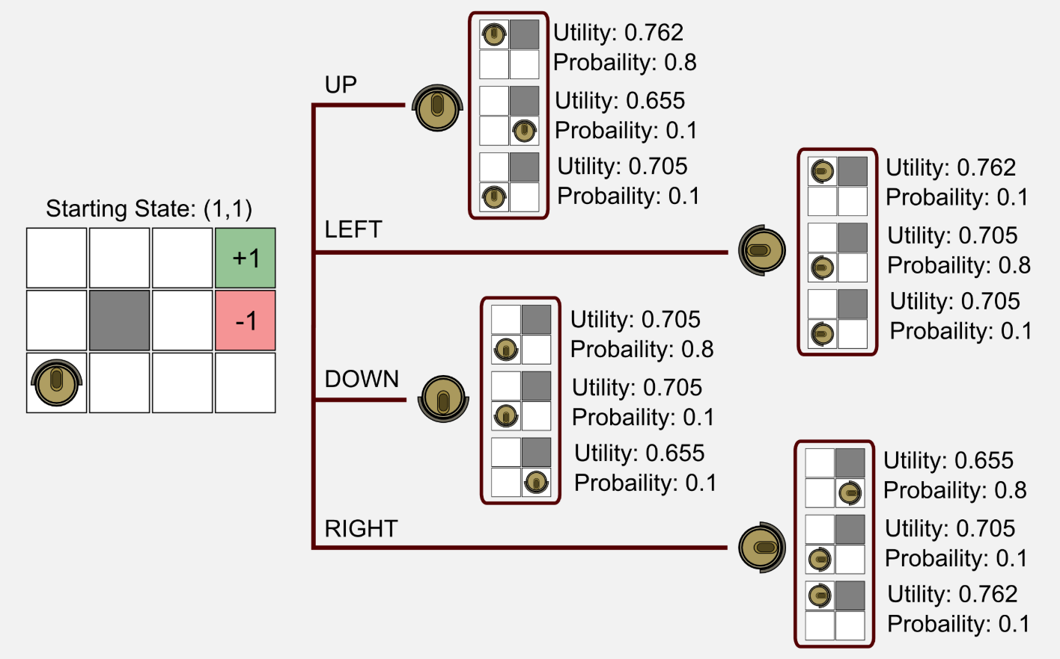
Bellman Equation Example
The Cleaning Robot Possible Outcomes
Note: The State-value function is also called the Utility Function
state-values

Slide 62
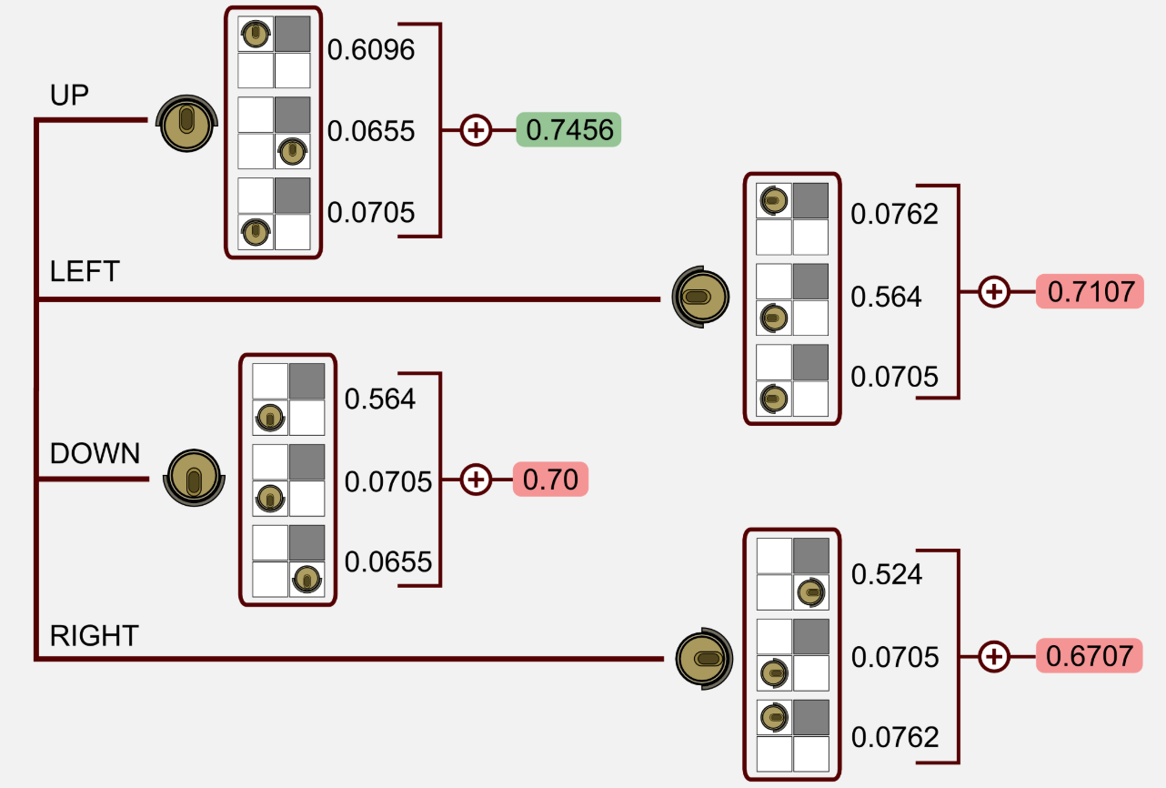

Bellman Equation Example
The next step is to calculate the product between the state-value and the transition probability, then sum up the value for each action
For state $(1,1)$, the action UP has the highest value
state-values

Slide 63
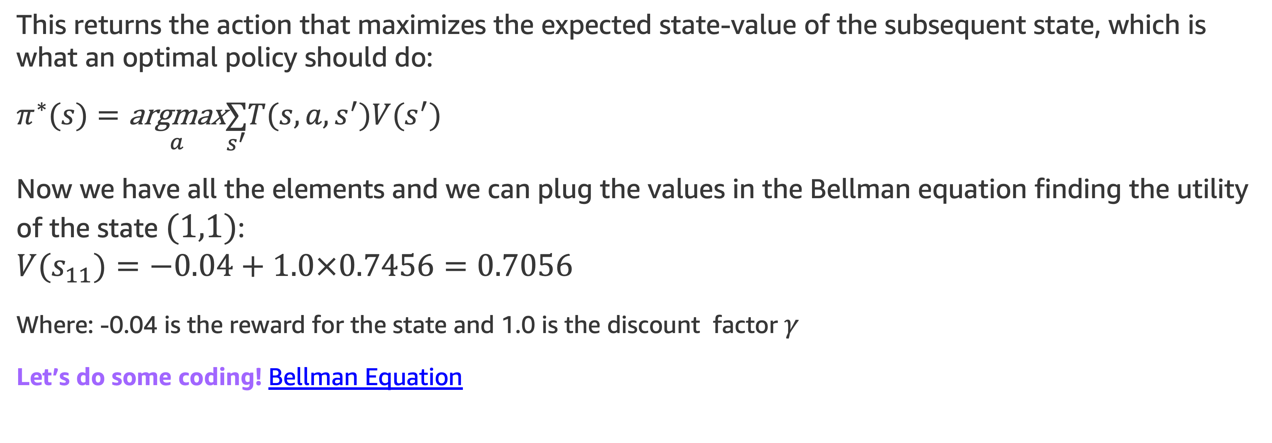
Bellman Equation Example
This returns the action that maximizes the expected state-value of the subsequent state, which is what an optimal policy should do:
$$π^{∗}(s)=\underset{a}{\text{argmax}}\overset{}{\underset{s^{′}}{∑}}T(s,a,s^{′})V(s^{′})$$
Now we have all the elements and we can plug the values in the Bellman equation finding the utility of the state $(1,1)$:
$$V(s_{11})=−0.04+1.0×0.7456=0.7056$$
Where: -0.04 is the reward for the state and 1.0 is the discount factor $γ$
Let’s do some coding! Bellman Equation
NEXT TOPIC: Dynamic Programming

Slide 64
Dynamic Programming

Slide 65
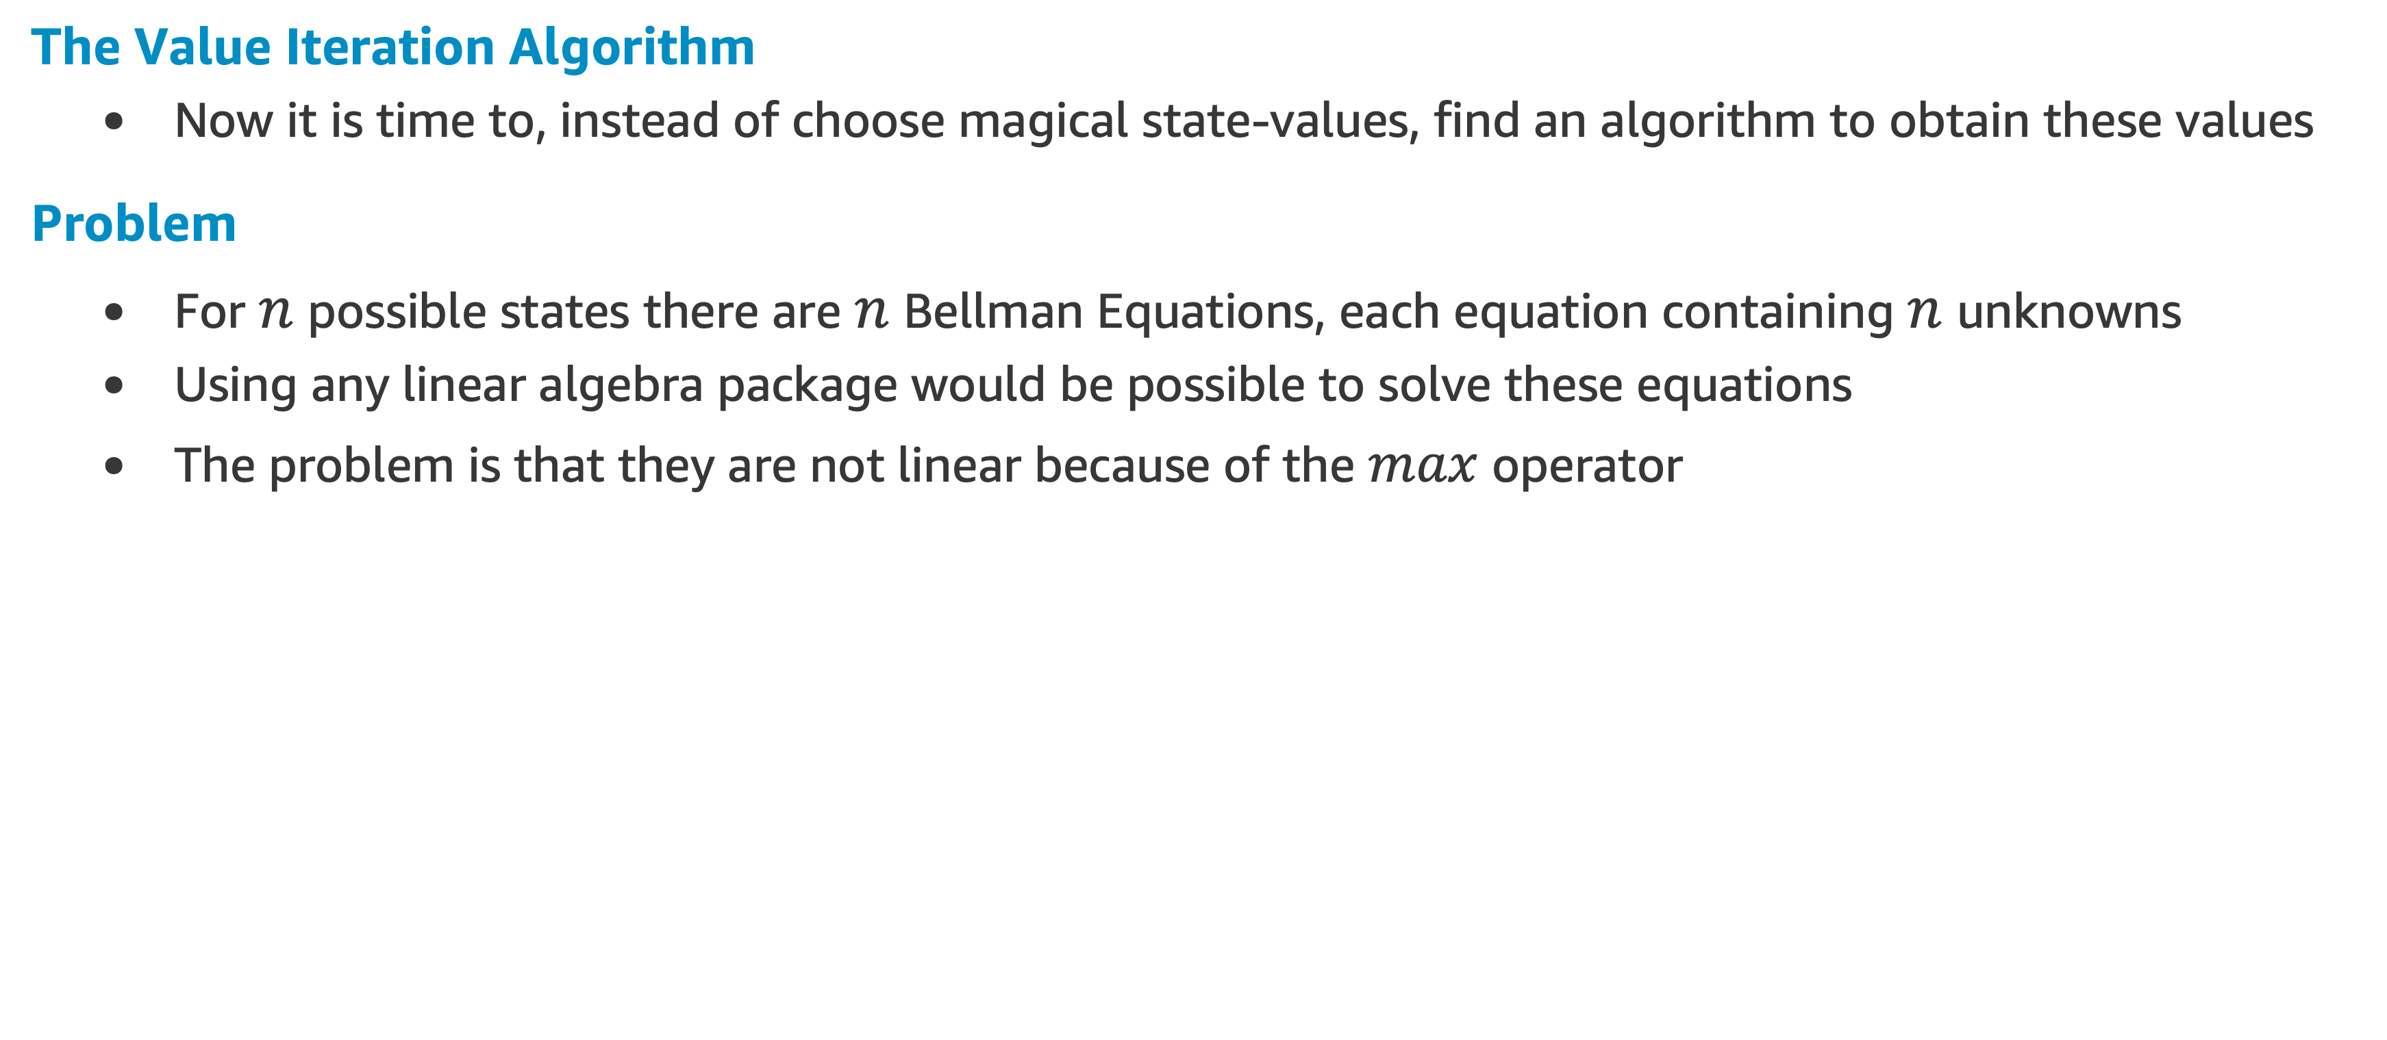
Dynamic Programming
The Value Iteration Algorithm
Now it is time to, instead of choose magical state-values, find an algorithm to obtain these values
Problem
For $n$ possible states there are $n$ Bellman Equations, each equation containing $n$ unknowns
Using any linear algebra package would be possible to solve these equations
The problem is that they are not linear because of the $max$ operator

Slide 66
Dynamic Programming
The Value Iteration Algorithm
The Bellman equation is the core of the value iteration algorithm for solving a MDP
The objective is to find the utility (also called state-value) for each state
Bellman Update Iteration:
We start with arbitrary initial values (usually zeros)
We calculate the utility of a state using the Bellman equation
We assign it to the state

Slide 67
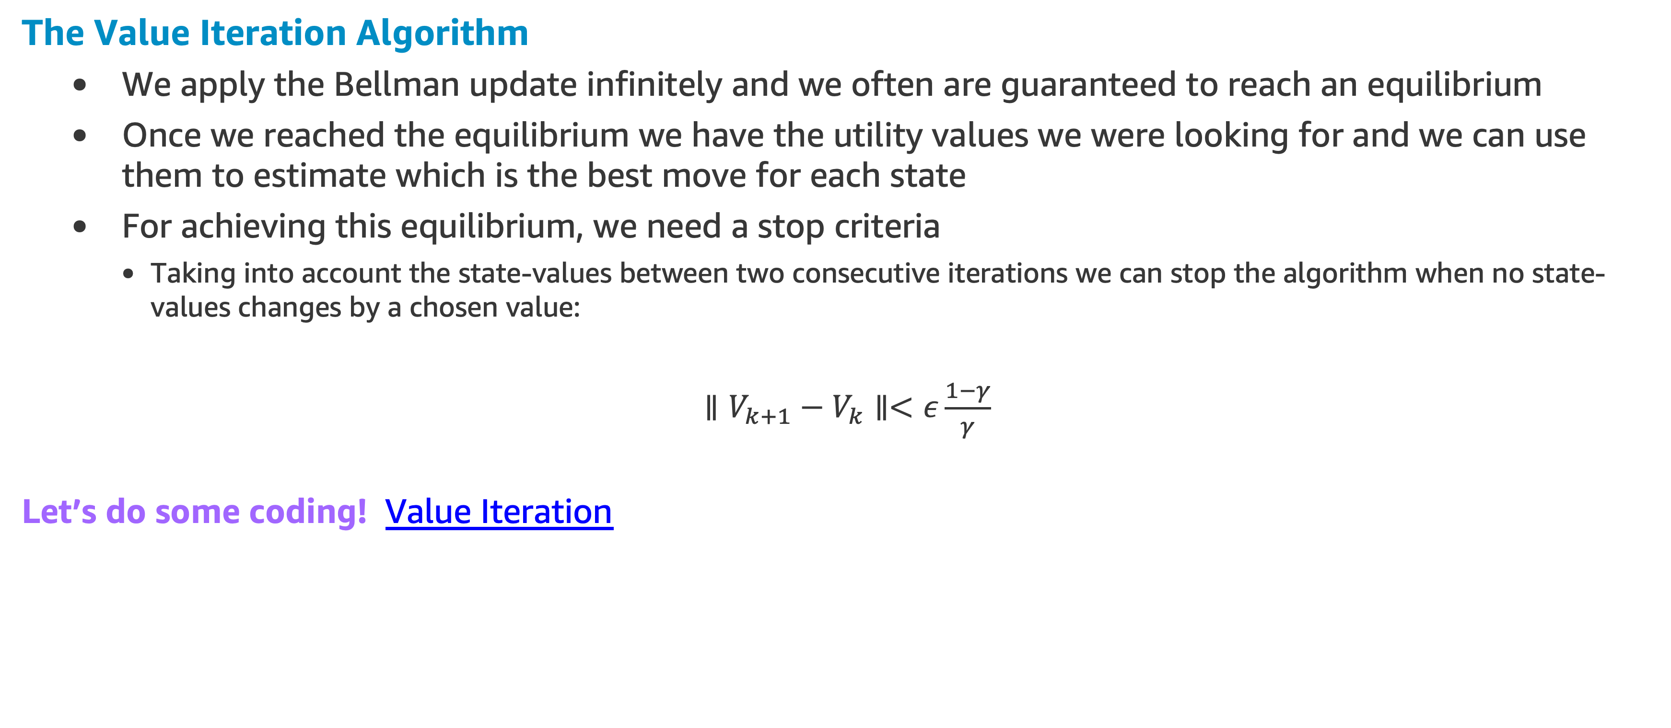
Dynamic Programming
The Value Iteration Algorithm
We apply the Bellman update infinitely and we often are guaranteed to reach an equilibrium
Once we reached the equilibrium we have the utility values we were looking for and we can use them to estimate which is the best move for each state
For achieving this equilibrium, we need a stop criteria
Taking into account the state-values between two consecutive iterations we can stop the algorithm when no state-values changes by a chosen value:
$∥V_{k+1}−V_{k}∥<ε\frac{1−γ}{γ}$
Let’s do some coding! Value Iteration

Slide 68
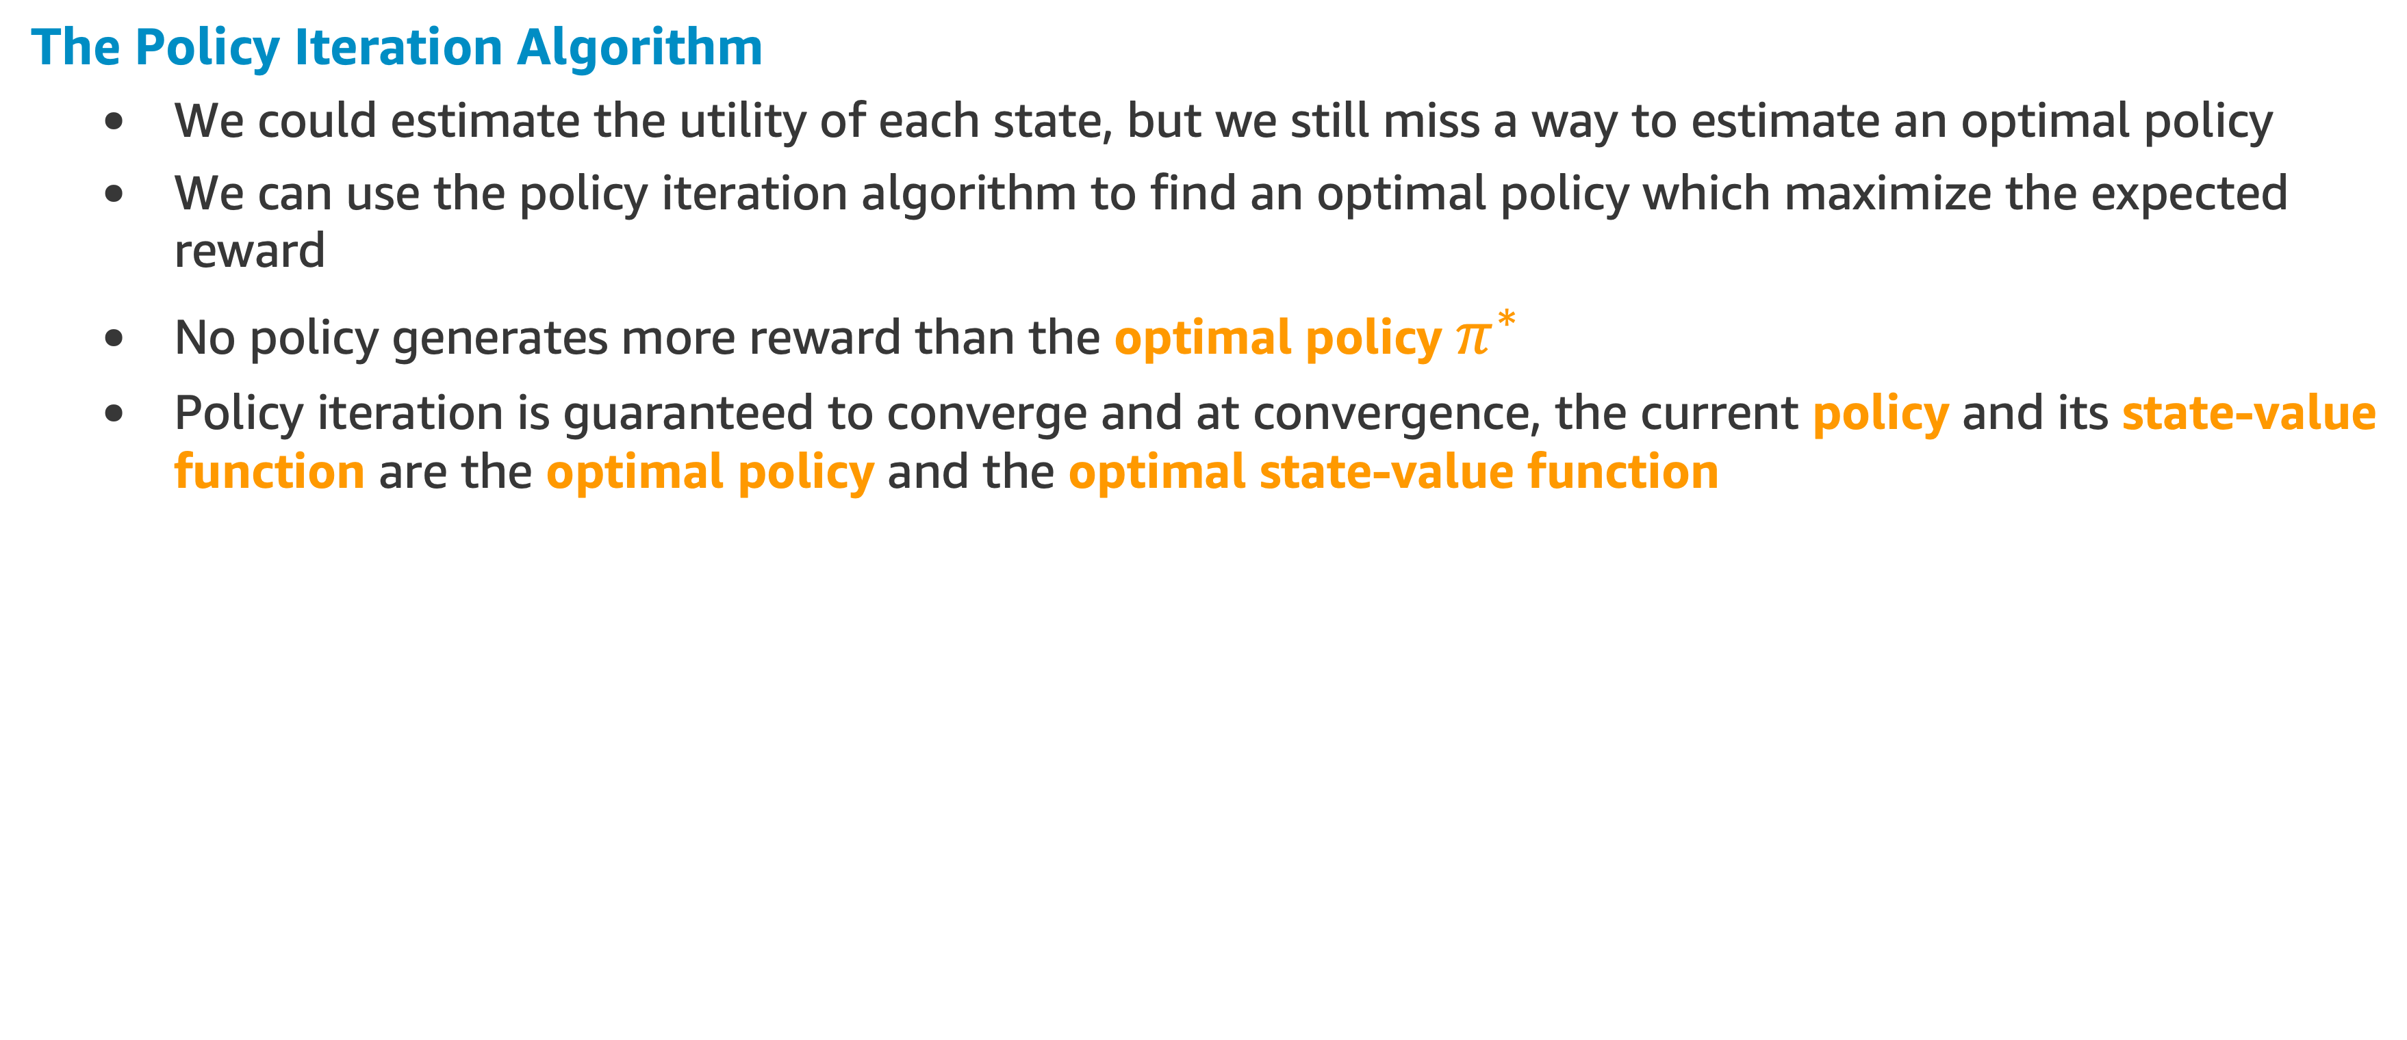
Dynamic Programming
The Policy Iteration Algorithm
We could estimate the utility of each state, but we still miss a way to estimate an optimal policy
We can use the policy iteration algorithm to find an optimal policy which maximize the expected reward
No policy generates more reward than the optimal policy $π^{∗}$
Policy iteration is guaranteed to converge and at convergence, the current policy and its state-value function are the optimal policy and the optimal state-value function

Slide 69
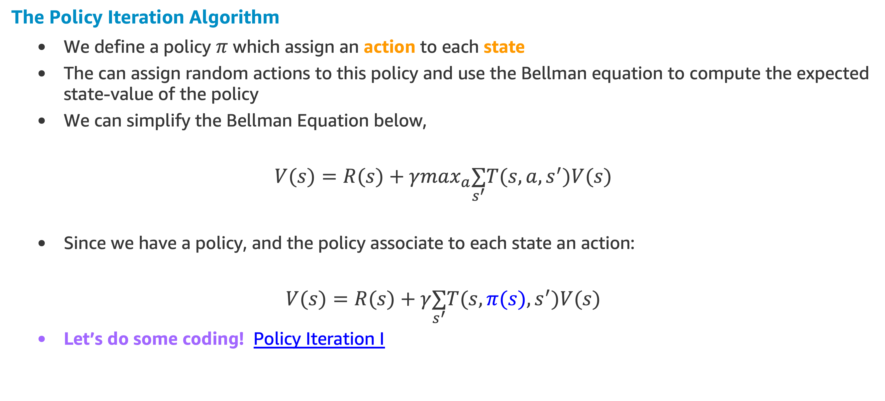
Dynamic Programming
The Policy Iteration Algorithm
We define a policy $π$ which assign an action to each state
The can assign random actions to this policy and use the Bellman equation to compute the expected state-value of the policy
We can simplify the Bellman Equation below,
$V(s)=R(s)+γmax_{a}\underset{s^{′}}{∑}T(s,a,s^{′})V(s)$
Since we have a policy, and the policy associate to each state an action:
$V(s)=R(s)+γ\underset{s^{′}}{∑}T(s,π(s),s^{′})V(s)$
Let’s do some coding! Policy Iteration I

Slide 70
Dynamic Programming Example
Another Robot Example
Problem/Task
Collecting empty cans from the ground
Rewards
0 every time the robot picks up a can
-1 for every move or attempt that runs into a wall
Possible Actions
Front/Back/Left/Right
If the robot runs into a wall, the next state is the same as the previous state

Slide 71
Dynamic Programming Example
Another Robot Example
Environment
A grid world with cans in some cells
The robot would be set free to wander around and learn to pick the cans
Termination State (End of One Episode)
Picking up 1 can (reaching reward = 0)
The robot would loop in the agent-environment cycle until the terminal state would be achieved

Slide 72
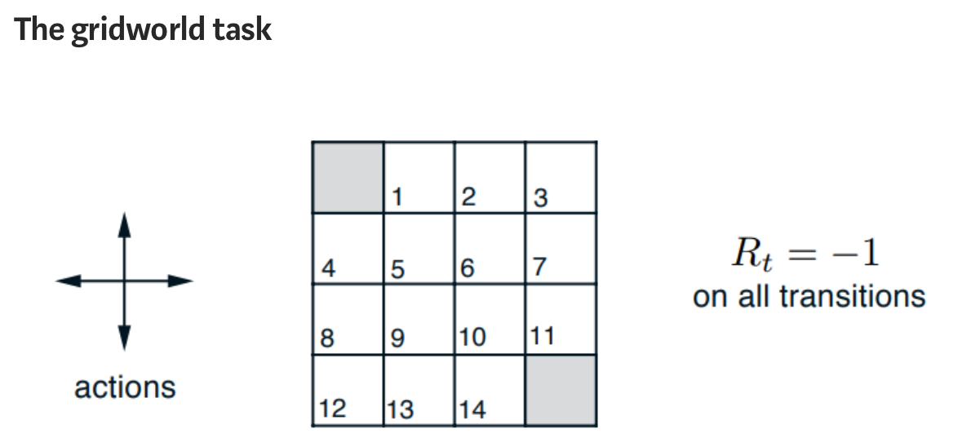
Dynamic Programming Example
Gray squares = cans
State = grid square

Slide 73
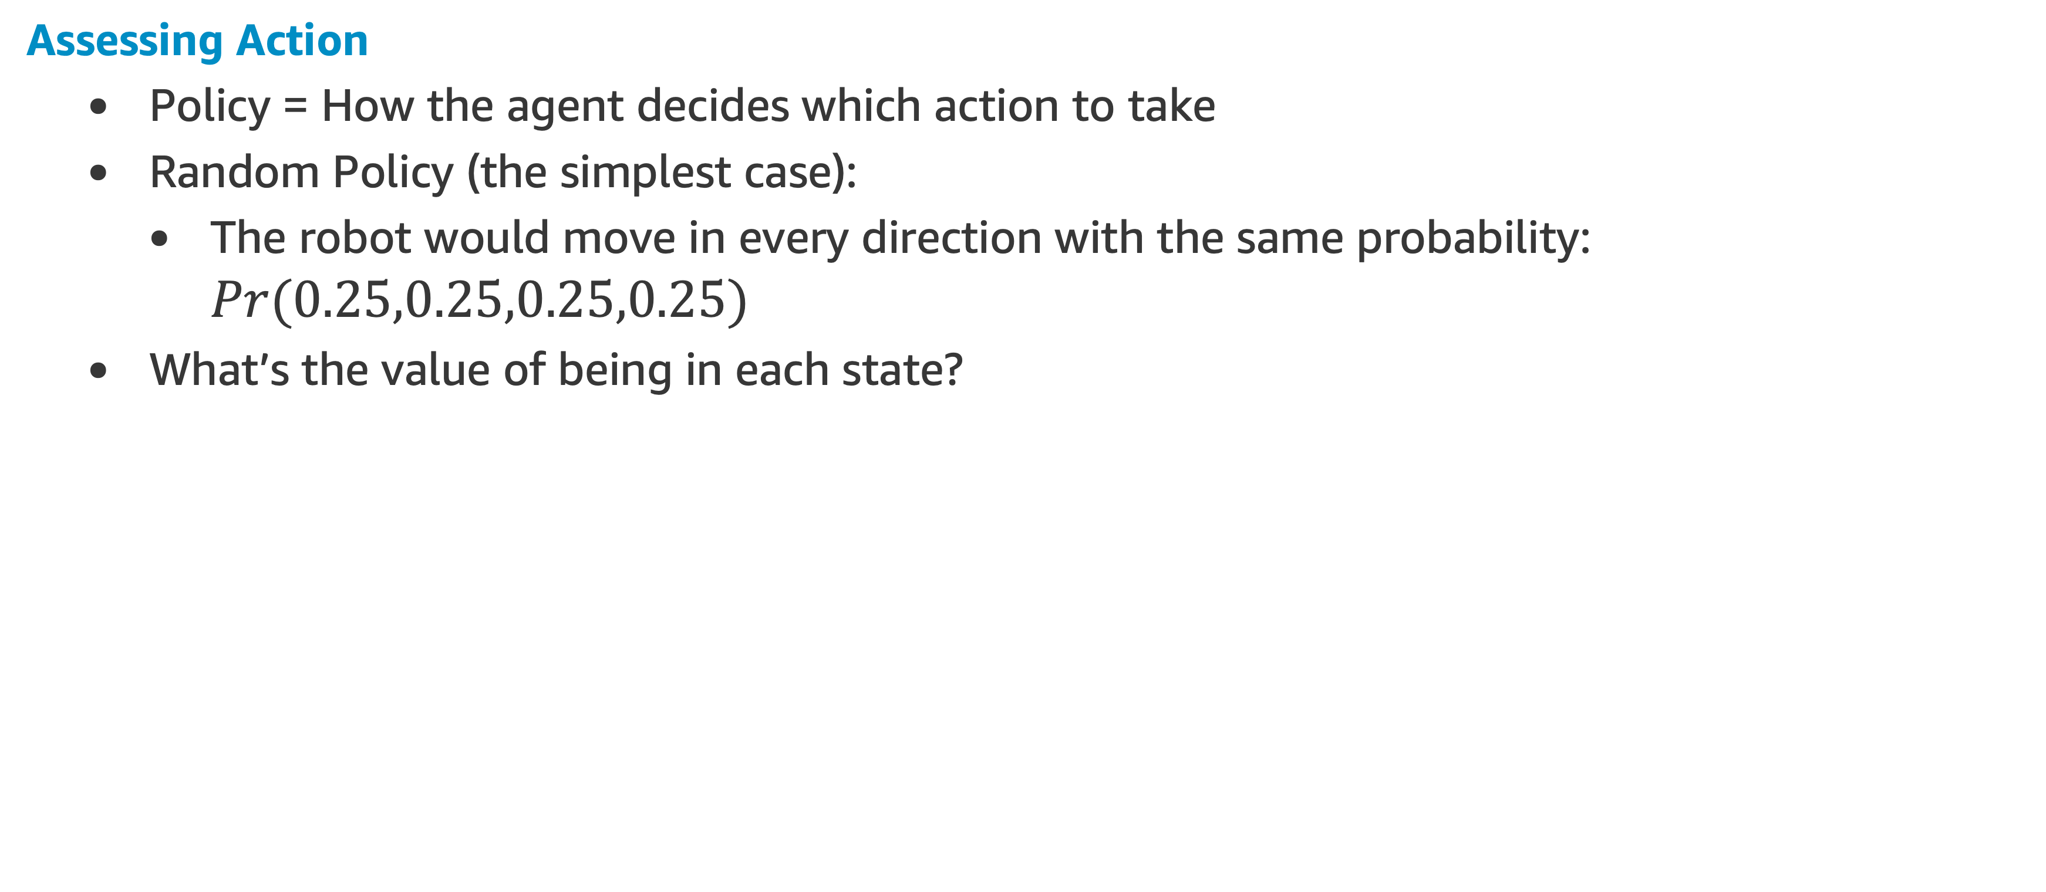
Dynamic Programming Example
Assessing Action
Policy = How the agent decides which action to take
Random Policy (the simplest case):
The robot would move in every direction with the same probability: $Pr(0.25,0.25,0.25,0.25)$
What’s the value of being in each state?

Slide 74
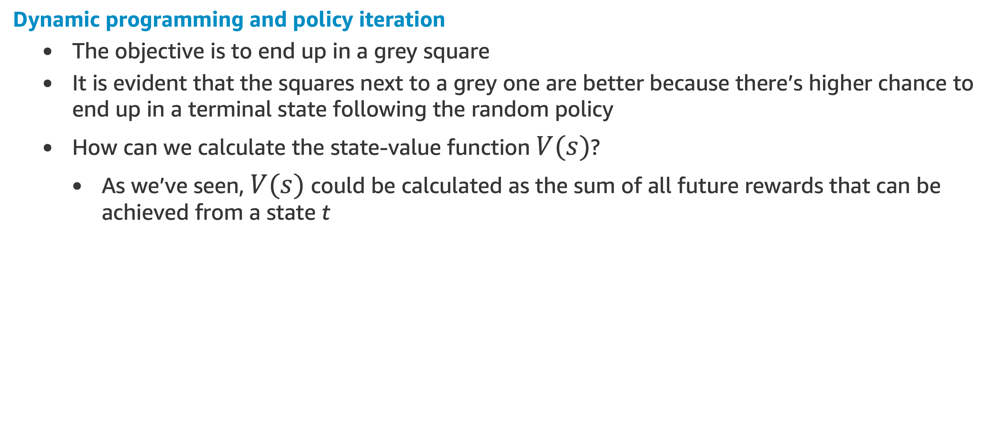
Dynamic Programming Example
Dynamic programming and policy iteration
The objective is to end up in a grey square
It is evident that the squares next to a grey one are better because there’s higher chance to end up in a terminal state following the random policy
How can we calculate the state-value function $V(s)$?
As we’ve seen, $V(s)$ could be calculated as the sum of all future rewards that can be achieved from a state t

Slide 75
Dynamic Programming Example
Algorithm
We initialize a value function that is an array of 4x4 dimensions (as big as the grid) with zeroes
We iterate for each state and we calculate its new value as the weighted sum of the reward (-1) plus the value of each neighbor states (s’)*
Finally, the V(s’) is multiplied by a gamma, which is the discounting factor (In our case we use gamma=1)
* the V(s’) is the expected value of the final/neighbor state s’ (at the beginning the expected value is 0 as we initialize the value function with zeroes)

Slide 76
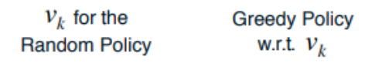
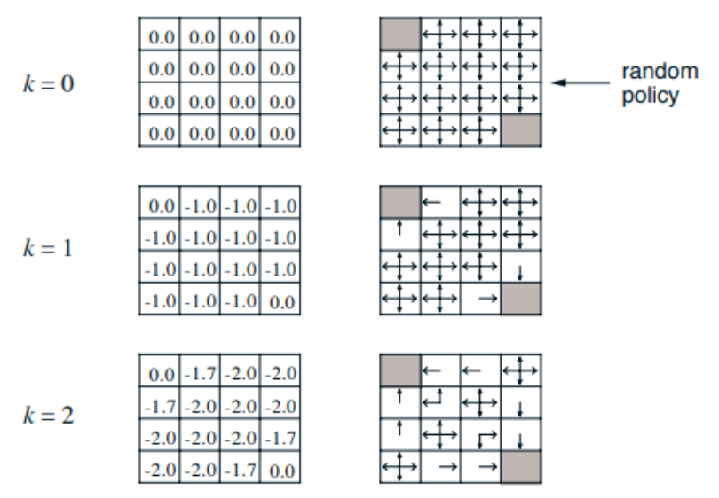
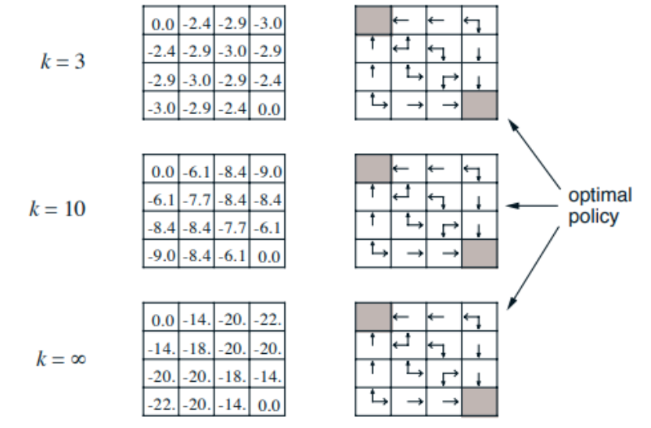
Dynamic Programming Example

Slide 77
Dynamic Programming Example
Notice that as we update the values of the states we can now generate more and more efficient policies until we reach the optimal “rules” a robot must follow to end up in the termination states as fast as possible
Let’s do some coding! Policy Iteration II

Slide 78
Summary

Slide 79
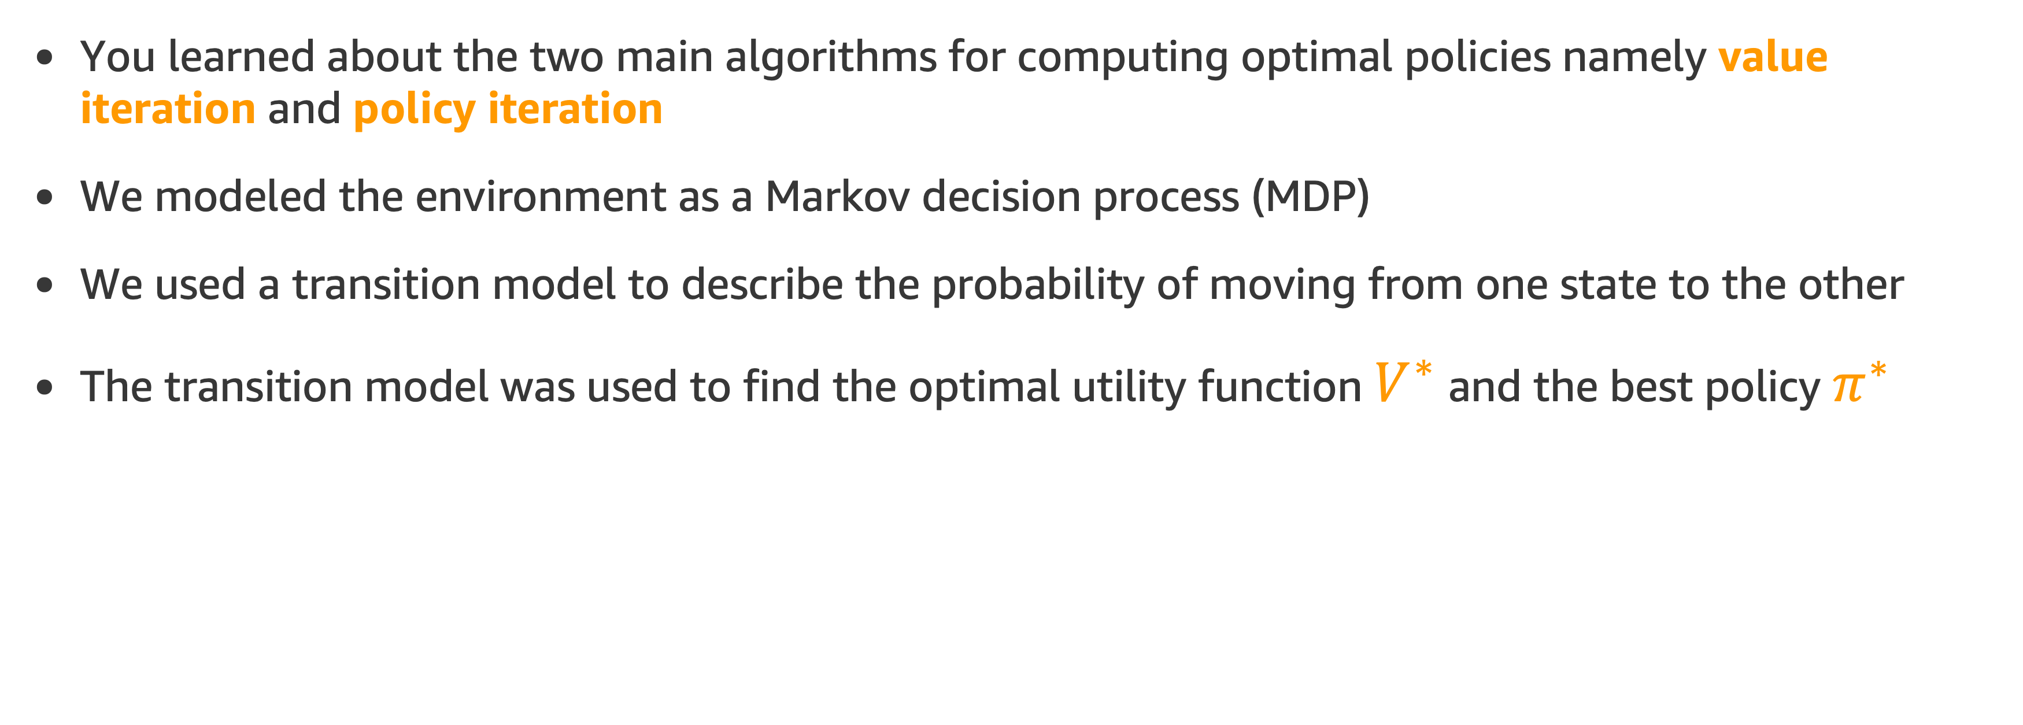
Summary
You learned about the two main algorithms for computing optimal policies namely value iteration and policy iteration
We modeled the environment as a Markov decision process (MDP)
We used a transition model to describe the probability of moving from one state to the other
The transition model was used to find the optimal utility function $V^{∗}$ and the best policy $π^{∗}$

Slide 80
References

Slide 81
References
[1] Reinforcement Learning: An Introduction, Sutton, R.S.,Barto, A.G.
[2] Dissecting Reinforcement Learning-Part.1
NEXT TOPIC: Assignments

Slide 82
Assignment

Slide 83
Assignment
Welcome to the first RL assignment
This week, we'll dive in to Dynamic Programming (DP) and Markov Decision Process (MDP)
A classical Gambler's problem will be used to implement these solutions
See detailed explanation of the Gambler’s problem in the assignment notebook RL_assignment_2.ipynb, located in your student’s Sagemaker environment

